Slide 1
Module 7 Infrastructure security and wireless security Part 1

Slide 2
Module 7 Learning Objectives
On successful completion of this module, Students should be able to:
logically construct networks using different types of network devices
describe how to enhance security through security devices
describe how to enhance security using NAC/NAP methodologies
identify and describe the different types of media used to carry network signals
describe different types of storage media used to store information
use basic terminology associated with network functions related to information security
describe different types and uses of cloud computing
describe the different wireless systems in use today
identify and describe IEEE 802.1's security issues and possible solutions
describe the elements needed for enterprise wireless deployment
describe the security of mobile systems

Slide 3
Module 7 Learning Resources
The readings from the text for this section are
‘Chapter 10 – Infrastructure security’ pp. 252-287
and ‘Chapter 12 Wireless Security’ pp. 336-375.

Slide 4
Key Terms
Basic packet filtering
Bridge
Cloud computing
Coaxial cable
Collision domain
Concentrator
Data loss prevention (DLP)
Firewall
Hub
Infrastructure as a Service (IaaS)
Internet content filter
Load balancer
Modem
Network access control
Notes:
Basic packet filtering – Filtering that looks at each packet entering or leaving the network and then either accepts the packet or rejects the packet based on user-defined rules. Each packet is examined separately.
Bridge – A network device that separates traffic into separate collision domains at the data layer of the OSI model.
Cloud computing – The automatic provisioning of on demand computational resources across a network.
Coaxial cable – A network cable that consists of a solid center core conductor and a physical spacer to the outer conductor which is wrapped around it. Commonly used in video systems.
Collision domain – An area of shared traffic in a network where packets from different conversations can collide.
Concentrator – A device used to manage multiple similar networking operations, such as provide a VPN endpoint for multiple VPNs.
Data loss prevention (DLP) – Technology, processes, and procedures designed to detect when unauthorized removal of data from a system occurs. DLP is typically
active, preventing the loss of data, either by blocking the transfer or dropping the connection.
Firewall – A network device used to segregate traffic based on rules.
Hub – A network device used to connect devices at the physical layer of the OSI model.
Infrastructure as a Service (IaaS) – The automatic, on-demand provisioning of infrastructure elements, operating as a service; a common element of cloud computing.
Internet content filter – A content-filtering system use to protect corporations from employees’ viewing of inappropriate or illegal content at the workplace and the subsequent complications that occur when such viewing takes place.
Load balancer – A network device that distributes computing across multiple computers.
Modem – A modulator/demodulator that is designed to connect machines via telephone-based circuits.
Network access control – An approach to endpoint security that involves monitoring and remediating endpoint security issues before allowing an object to connect to a network.

Slide 5
Key Terms (continued)
Network Access Protection (NAP)
Network Admission Control (NAC)
Network Attached Storage (NAS)
Network interface card (NIC)
Network operations center (NOC)
Next-generation firewall
Platform as a Service (PaaS)
Private branch exchange (PBX)
Proxy server
Notes:
Network Access Protection (NAP) – A Microsoft approach to network access control.
Network Admission Control (NAC) – The Cisco technology approach for generic network access control.
Network Attached Storage (NAS) – The connection of storage to a system via a network connection.
Network interface card (NIC) – A piece of hardware designed to connect machines at the physical layer of the OSI model.
Network operations center (NOC) – A control point from where network performance can be monitored and managed.
Next-generation firewall – Firewall technology based on packet contents as opposed to simple address and port information.
Platform as a Service (PaaS) – The concept of having provisionable operational platforms that can be obtained via a service.
Private branch exchange (PBX) – A telephone exchange that serves a specific business or entity.
Proxy server – A server that acts as a proxy for individual requests and is used for performance and security purposes in a scalable fashion.

Slide 6
Key Terms (continued)
Router
Sandboxing
Servers
Shielded twisted-pair (STP)
Software as a Service (SaaS)
Solid-state drive (SSD)
Switch
Unified threat management (UTM)
Unshielded twisted-pair (UTP)
Virtualization
Web security gateway
Wireless access point
Workstation
Notes:
Router – A network device that operates at the network layer of the OSI model.
Sandboxing – The concept of isolating a system and specific processes form the OS in order to provide specific levels of security.
Servers – The computers in a network that host applications and data for everyone to share.
Shielded twisted-pair (STP) – A physical network connection consisting of two wires twisted and covered with a shield to prevent interference.
Software as a Service (SaaS) – The provisioning of software as a service, commonly known as on-demand software.
Solid-state drive (SSD) – A mass storage device, such as a hard drive, that is composed of electronic memory as opposed to a physical device of spinning platters.
Switch – A network device that operates at the data layer of the OSI model.
Unified threat management (UTM) – The aggregation of multiple network security products into a single appliance for efficiency purposes.
Unshielded twisted-pair (UTP) – A form of network cabling in which pairs of wires are twisted to reduce crosstalk. Commonly used in LANs.
Virtualization – An abstraction of the OS layer, creating the ability to host multiple OSs on a single piece of hardware.
Web security gateway – A device that combines proxy functions with content-filtering functions with the intention of addressing the security threats and pitfalls unique to web-based traffic.
Wireless access point – A network access device that facilitates the connection of wireless devices to a network.
Workstation – The machine that sits on the desktop and is used every day for sending and reading e-mail, creating spreadsheets, writing reports in a word processing program, and playing games.

Slide 7
Devices
Devices are needed to connect clients and servers and to regulate the traffic between them.
Devices expand the network beyond simple client computers and servers.
Devices come in many forms and with many functions.
Each device has a specific network function and plays a role in maintaining network infrastructure security.
Notes:
A complete network computer solution in today’s business environment consists of more than just client computers and servers.
Devices are needed to expand a network beyond simple client computers and servers to include yet other devices, such as wireless and handheld systems.
Devices come in many forms and with many functions, from hubs and switches, to routers, wireless access points, and special-purpose devices such as virtual private network (VPN) devices.

Slide 8
Workstations
The workstation is the machine that sits on the desktop.
It is used every day for sending and reading e-mail, creating spreadsheets, writing reports in a word processing program, and playing games.
A workstation connected to a network is an important part of the network security solution.
Many threats to information security can start at a workstation, but much can be done in a few simple steps to provide protection from many of these threats.
Notes:
Most users are familiar with the client computers used in the client/server model called workstation devices.

Slide 9
Servers
Servers are the computers in a network that host applications and data for everyone to share.
Servers come in many sizes.
Server operating systems range from Windows Server, to UNIX, to Multiple Virtual Storage (MVS) and other mainframe operating systems
They tend to be more robust than workstation OSs.
They are designed to service multiple users over a network at the same time.
Servers can host a variety of applications.
Notes:
Servers come in many sizes, from small single-CPU boxes that may be less powerful than a workstation, to multiple-CPU monsters, up to and including mainframes.
The operating systems used by servers range from Windows Server, to UNIX, to Multiple Virtual Storage (MVS) and other mainframe operating systems.
The OS on a server tends to be more robust than the OS on a workstation system and is designed to service multiple users over a network at the same time.
Servers can host a variety of applications, including web servers, databases, e-mail servers, file servers, print servers, and application servers for middleware applications.

Slide 10
Virtualization
Virtualization technology is used to allow a computer to have more than one OS present and, in many cases, operating at the same time.
Virtualization is an abstraction of the OS layer.
It creates the ability to host multiple OSs on a single piece of hardware.
A major advantage of virtualization is the separation of the software and the hardware.
It creates a barrier that can improve many system functions, including security.

Slide 11
Virtualization (continued)
The underlying hardware is referred to as the host machine, and on it is a host OS.
A hypervisor is needed to manage virtual machines (VMs).
Virtual machines are typically referred to as the guest OSs.
Newer OSs are designed to natively incorporate virtualization hooks.
Common virtualization solutions include:
Microsoft Hyper-V, VMware, Oracle VM VirtualBox, Parallels, and Citrix Xen
Notes:
Exam Tip: A hypervisor is the interface between a virtual machine and the host machine hardware. Hypervisors are the layer that enables virtualization.
Either the host OS has built-in hypervisor capability or an application is needed to provide the hypervisor function to manage the virtual machines (VMs).
Newer OSs are designed to natively incorporate virtualization hooks, enabling virtual machines to be employed with greater ease.

Slide 12
Virtualization (continued)
A snapshot is a point-in-time saving of the state of a virtual machine.
Patches are still needed and should be applied, independent of the virtualization status.
In a virtualization environment, protecting the host OS and hypervisor level is critical for system stability.
Best practice is to avoid the installation of any applications on the host-level machine.
Elasticity refers to the ability of a system to expand/contract as system requirements dictate.
Notes:
Snapshots have great utility because they are like a savepoint for an entire system. Snapshots can be used to roll a system back to a previous point in time, undo operations, or provide a quick means of recovery from a complex, system-altering change that has gone awry. Snapshots can be used to roll a system back to a previous point in time, undo operations, or provide a quick means of recovery from a complex, system-altering change that has gone awry. Snapshots act as a form of backup and are typically much faster than normal system backup and recovery operations.
Having an OS operate in a virtual environment does not change the need for security associated with the OS.
When you set up a virtualization environment, protecting the host OS and hypervisor level is critical for system stability. The best practice is to avoid the installation of any applications on the host-level machine. All apps should be housed and run in a virtual environment. This aids in the stability by providing separation between the application and the host OS. The term elasticity refers to the ability of a system to expand/contract as system requirements dictate. One of the advantages of virtualization is that a virtual machine can be moved to larger or smaller environments based on needs. If a VM needs more processing power, then migrating the VM to a new hardware system with greater CPU capacity allows the system to expand without having to rebuild it.

Slide 13
Virtualization (continued)
It is important to test the controls applied to a system to manage security operations to ensure that they are providing the desired results.
It is essential to specifically test all security controls inside the virtual environment to ensure their behavior is still effective.
Sandboxing refers to the quarantine or isolation of a system from its surroundings.
Virtualization can be used as a form of sandboxing with respect to an entire system.
Notes:
When applying security controls to a system to manage security operations, it is important to test the controls to ensure that they are providing the desired results. Putting a system into a VM does not change this requirement. In fact, it may complicate it because of the nature of the guest OS to hypervisor relationship.
You can build a VM, test something inside the VM, and, based on the results, make a decision with regard to stability or whatever concern was present.

Slide 14
Mobile Devices
Mobile devices such as laptops, tablets, and mobile phones are the latest devices to join the corporate network.
Mobile devices can create a major security gap, as a user may access separate e-mail accounts, one personal, without antivirus protection, and the other corporate.

Slide 15
Device Security, Common Concerns
As more and more interactive devices are being designed, a new threat source has appeared.
Default accounts and passwords are well known in the hacker community.
First steps you must take to secure such devices is to change the default credentials.
Notes:
In an attempt to build security into devices, typically, a default account and password must be entered to enable the user to access and configure the device remotely. These default accounts and passwords are well known in the hacker community, so one of the first steps you must take to secure such devices is to change the default credentials. Anyone who has purchased a home office router knows the default configuration settings and can check to see if another user has changed theirs. If they have not, this is a huge security hole, allowing outsiders to “reconfigure” their network devices.

Slide 16
Network Attached Storage
Because of the speed of today’s Ethernet networks, it is possible to manage data storage across the network.
This has led to a type of storage known as Network Attached Storage (NAS).
The combination of inexpensive hard drives, fast networks, and simple application-based servers has made NAS devices in the terabyte range affordable for even home users.
As a network device, it is susceptible to attacks.
Notes:
Because of the large size of video files, this has become popular for some users as a method of storing TV and video libraries. Because NAS is a network device, it is susceptible to various attacks, including sniffing of credentials and a variety of brute-force attacks to obtain access to the data.

Slide 17
Removable Storage
Removable devices can move data outside of the corporate-controlled environment.
Removable devices can bring unprotected or corrupted data into the corporate environment.
All removable devices should be scanned by antivirus software upon connection to the corporate environment.
Corporate policies should address the copying of data to removable devices.
Notes:
Many mobile devices can be connected via USB to a system and used to store data—and in some cases vast quantities of data. This capability can be used to avoid some implementations of data loss prevention mechanisms.

Slide 18
Networking
Networks are used to connect devices together.
Networks are composed of components that perform networking functions to move data between devices.
Networks begin with network interface cards, then continue in layers of switches and routers.
Specialized networking devices are used for specific purposes, such as security and traffic management.

Slide 19
Network Interface Cards
To connect a server or workstation to a network, a device known as a network interface card (NIC) is used.
A NIC is the physical connection between a computer and the network.
Each NIC port is serialized with a unique code, 48 bits long, referred to as a Media Access Control address (MAC address).
Unfortunately, these addresses can be changed, or “spoofed,” rather easily.
Notes:
A NIC is a card with a connector port for a particular type of network connection, either Ethernet or Token Ring. The most common network type in use for LANs is the Ethernet protocol, and the most common connector is the RJ-45 connector.
The purpose of a NIC is to provide lower-level protocol functionality from the OSI (Open System Interconnection) model. Because the NIC defines the type of physical layer connection, different NICs are used for different physical protocols.
NICs come as single-port and multiport, and most workstations use only a single-port NIC, as only a single network connection is needed. For servers, multiport NICs are used to increase the number of network connections, increasing the data throughput to and from the network.
Each NIC port is serialized with a unique code, 48 bits long, referred to as a Media Access Control address (MAC address). These are created by the manufacturer, with 24 bits representing the manufacturer and 24 bits being a serial number, guaranteeing uniqueness. MAC addresses are used in the addressing and delivery of network packets to the correct machine and in a variety of security situations.
Unfortunately, these addresses can be changed, or “spoofed,” rather easily. In fact, it is common for personal routers to clone a MAC address to allow users to use multiple devices over a network connection that expects a single MAC.

Slide 20
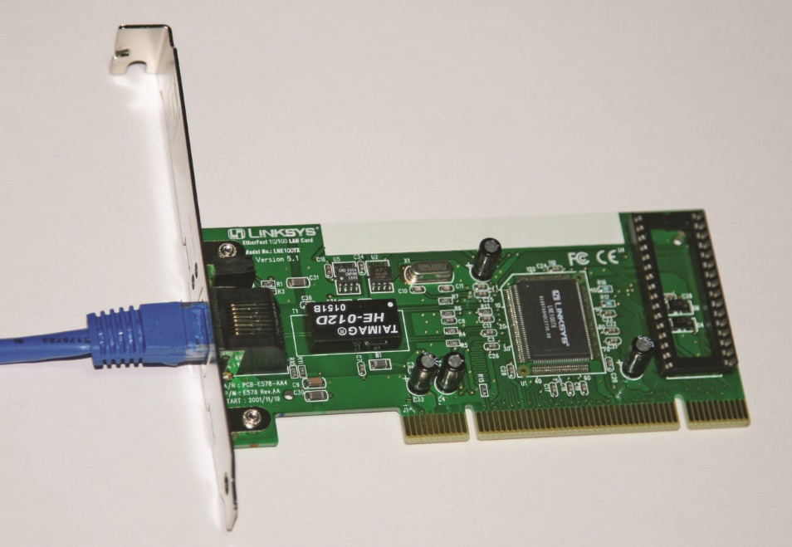
Figure 10.1 Linksys network interface card (NIC)
Notes:
This figure shows a common form of a NIC.

Slide 21
Hubs
A hub is networking equipment that connects devices that are using the same protocol at the physical layer of the OSI model.
A hub allows multiple machines in an area to be connected together in a star configuration with the hub at the center.
All connections on a hub share a single collision domain, a small cluster in a network where collisions occur.
Increased network traffic can become limited by collisions; this problem has made hubs obsolete in newer networks.
Hubs also create a security weakness due to sniffing and eavesdropping issues.
Notes:
A hub configuration can save significant amounts of cable and is an efficient method of configuring an Ethernet backbone.
The collision issue has made hubs obsolete in newer, higher performance networks, with inexpensive switches and switched Ethernet keeping costs low and usable bandwidth high. Hubs also create a security weakness in that all connected devices see all traffic, enabling sniffing and eavesdropping to occur. In today’s networks, hubs have all but disappeared, being replaced by low-cost switches.

Slide 22
Bridges
A bridge operates at the data link layer, filtering traffic based on MAC addresses.
Bridges can reduce collisions by separating pieces of a network into two separate collision domains.
This only cuts the collision problem in half.
A better solution is to use switches for network connections.
Notes:
Bridges are networking equipment that connect devices using the same protocol at the data link layer of the OSI model.

Slide 23
Switches
A switch forms the basis for connections in most Ethernet-based LANs.
Switches have replaced hubs and bridges.
A switch has separate collision domains for each port.
When full duplex is employed, collisions are virtually eliminated from the two nodes, host and client.
A switch is usually a Layer 2 device, but Layer 3 switches incorporate routing functionality.
Notes:
A switch has separate collision domains for each port. This means that for each port, two collision domains exist: one from the port to the client on the downstream side, and one from the switch to the network upstream. When full duplex is employed, collisions are virtually eliminated from the two nodes, host and client. This also acts as a hub-based system, where a single sniffer can see all of the traffic to and from connected devices.
Switches operate at the data link layer, while routers act at the network layer. For intranets, switches have become what routers are on the Internet—the device of choice for connecting machines. As switches have become the primary network connectivity device, additional functionality has been added to them. A switch is usually a Layer 2 device, but Layer 3 switches incorporate routing functionality.

Slide 24
Switches (continued)
Advantages of switches
They improve network performance by filtering traffic.
They provide the option to disable a port so that it cannot be used without authorization.
They support port security allowing the administrator to control which systems can send data to each of the ports.
Switches use the MAC address of the systems to incorporate traffic filtering and port security features.
Port address security based on MAC addresses functionality is what allows an 802.1X device to act as an “edge device.”
Notes:
A switch filters traffic by only sending the data to the port on the switch that the destination system resides on. The switch knows what port each system is connected to and sends the data only to that port.
The switch uses the MAC address of the systems to incorporate traffic filtering and port security features, which is why it is considered a Layer 2 device.
Port address security based on MAC addresses can determine whether a packet is allowed or blocked from a connection. This is the very function that a firewall uses for its determination, and this same functionality is what allows an 802.1X device to act as an “edge device.”

Slide 25
Switches (continued)
Switch security concerns
They are intelligent network devices and are therefore subject to hijacking by hackers.
Switches are commonly administered using the Simple Network Management Protocol (SNMP) and Telnet protocol.
Both protocols have a serious weakness in that they send passwords across the network in cleartext.
Switches are shipped with default passwords.
Switches are subject to electronic attacks, such as ARP poisoning and MAC flooding.
Notes:
One of the security concerns with switches is that, like routers, they are intelligent network devices and are therefore subject to hijacking by hackers. Should a hacker break into a switch and change its parameters, he might be able to eavesdrop on specific or all communications, virtually undetected. Switches are commonly administered using the Simple Network Management Protocol (SNMP) and Telnet protocol, both of which have a serious weakness in that they send passwords across the network in cleartext. A hacker armed with a sniffer that observes maintenance on a switch can capture the administrative password. This allows the hacker to come back to the switch later and configure it as an administrator. An additional problem is that switches are shipped with default passwords, and if these are not changed when the switch is set up, they offer an unlocked door to a hacker.
Switches are also subject to electronic attacks, such as ARP poisoning and MAC flooding. ARP poisoning is where a device spoofs the MAC address of another device, attempting to change the ARP tables through spoofed traffic and the ARP table-update mechanism. MAC flooding is where a switch is bombarded with packets from different MAC addresses, flooding the switch table and forcing the device to respond by opening all ports and acting as a hub. This enables devices on other segments to sniff traffic.

Slide 26
Switches (continued)
Loop protection is a concern with switches.
Switches operate at Layer 2 so there is no countdown mechanism to kill packets that get caught in loops or on paths that will never resolve.
The Layer 2 space acts as a mesh, where potentially the addition of a new device can create loops in the existing device interconnections.
Spanning trees technology is employed to prevent loops.
The Spanning Tree Protocol (STP) allows for multiple, redundant paths, while breaking loops to ensure a proper broadcast pattern.

Slide 27
Routers
A router is a network traffic management device used to connect different network segments.
Operate at the network layer (Layer 3) of the OSI model
Form the backbone of the Internet
Use algorithms and tables to determine where to send the packet
Use access control lists (ACLs) as a method of deciding whether a packet is allowed to enter the network
Must limit router access and control of internal functions
Notes:
Routers operate at the network layer (Layer 3) of the OSI model, using the network address (typically an IP address) to route traffic and using routing protocols to determine optimal routing paths across a network. Routers form the backbone of the Internet, moving traffic from network to network, inspecting packets from every communication as they move traffic in optimal paths. Routers operate by examining each packet, looking at the destination address, and using algorithms and tables to determine where to send the packet next. This process of examining the header to determine the next hop can be done in quick fashion.
Routers use access control lists (ACLs) as a method of deciding whether a packet is allowed to enter the network. With ACLs, it is also possible to examine the source address and determine whether or not to allow a packet to pass. This allows routers equipped with ACLs to drop packets according to rules built into the ACLs. This can be a cumbersome process to set up and maintain, and as the ACL grows in size, routing efficiency can be decreased. It is also possible to configure some routers to act as quasi–application gateways, performing stateful packet inspection and using contents as well as IP addresses to determine whether or not to permit a packet to pass. This can tremendously increase the time for a router to pass traffic and can significantly decrease router throughput. Configuring ACLs and other aspects of setting up routers for this type of use are beyond the scope of this book.
One serious security concern regarding router operation is limiting who has access to the router and control of its internal functions. Like a switch, a router can be accessed using SNMP and Telnet and programmed remotely. Because of the geographic separation of routers, this can become a necessity, for many routers in the world of the Internet can be hundreds of miles apart, in separate locked structures. Physical control over a router is absolutely necessary, for if any device, be it a server, switch, or router, is physically accessed by a hacker, it should be considered compromised. Thus, such access must be prevented. As with switches, it is important to ensure that the administrator password is never passed in the clear, that only secure mechanisms are used to access the router, and that all of the default passwords are reset to strong passwords.
As with switches, the most assured point of access for router management control is via the serial control interface port. This allows access to the control aspects of the router without having to deal with traffic-related issues. For internal company networks, where the geographic dispersion of routers may be limited, third-party solutions to allow out-of-band remote management exist. This allows complete control over the router in a secure fashion, even from a remote location, although additional hardware is required.

Slide 28
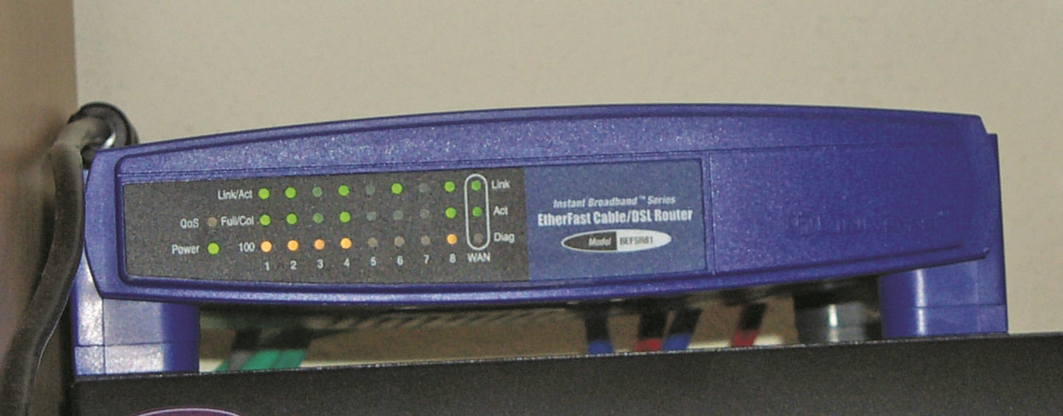
Figure 10.2 A small home office router for cable modem/DSL
Notes:
Routers are available from numerous vendors and come in sizes big and small. A typical small home office router for use with cable modem/DSL service is shown in this figure. Larger routers can handle traffic of up to tens of gigabytes per second per channel, using fiberoptic inputs and moving tens of thousands of concurrent Internet connections across the network. These routers, which can cost hundreds of thousands of dollars, form an essential part of e-commerce infrastructure, enabling large enterprises such as Amazon and eBay to serve many customers’ use concurrently.

Slide 29
Firewalls
A firewall is a network device—hardware, software, or a combination thereof.
Its purpose is to enforce a security policy across its connections by allowing or denying traffic to pass into or out of the network.
The heart of a firewall is the set of security policies that it enforces.
A key to security policies for firewalls is the principle of least access.
Notes:
The heart of a firewall is the set of security policies that it enforces. Management determines what is allowed in the form of network traffic between devices, and these policies are used to build rule sets for the firewall devices used to filter network traffic across the network.
Firewall security policies are a series of rules that defines what traffic is permissible and what traffic is to be blocked or denied. These are not universal rules, and there are many different sets of rules for a single company with multiple connections. A web server connected to the Internet may be configured only to allow traffic on port 80 for HTTP, and have all other ports blocked. An e-mail server may have only necessary ports for e-mail open, with others blocked.
A key to security policies for firewalls is the same as has been seen for other security policies—the principle of least access. Only allow the necessary access for a function; block or deny all unneeded functionality. How an organization deploys its firewalls determines what is needed for security policies for each firewall.

Slide 30
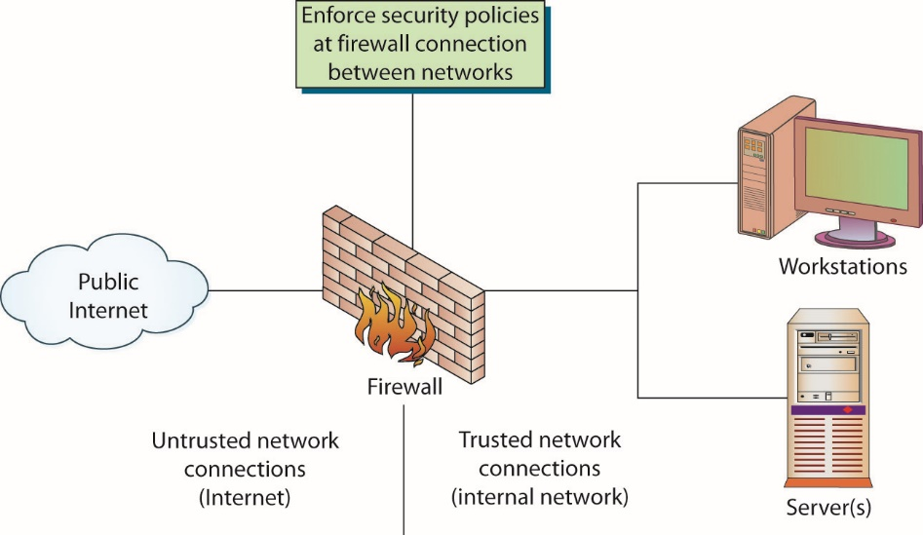
Figure 10.3 How a firewall works
Notes:
A firewall is a lot like a gate guard at a secure facility. The guard examines all the traffic trying to enter the facility—cars with the correct sticker or delivery trucks with the appropriate paperwork are allowed in; everyone else is turned away.

Slide 31
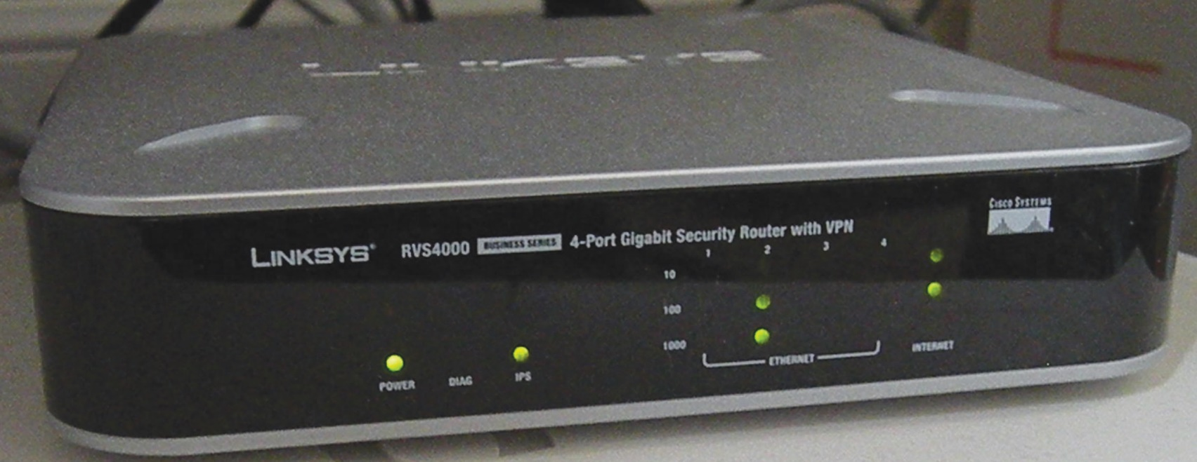
Figure 10.4 Linksys RVS4000 SOHO firewall
Notes:
You may have a small office–home office firewall at your house, such as the RVS4000 shown in this figure. This device from Linksys provides both routing and
firewall functions.

Slide 32
Firewalls (continued)
The security topology determines what network devices are employed at what points in a network.
The perfect firewall policy is one that the end user never sees and one that never allows even a single unauthorized packet to enter the network.
To develop a complete and comprehensive security policy, it is first necessary to have a complete and comprehensive understanding of your network resources and their uses.
Notes:
The security topology determines what network devices are employed at what points in a network.
The perfect firewall policy is one that the end user never sees and one that never allows even a single unauthorized packet to enter the network. As with any other perfect item, it will be rare to find the perfect security policy for a firewall.
To develop a complete and comprehensive security policy, it is first necessary to have a complete and comprehensive understanding of your network resources and their uses. Once you know what your network will be used for, you will have an idea of what to permit. Also, once you understand what you need to protect, you will have an idea of what to block. Firewalls are designed to block attacks before they get to a target machine. Common targets are web servers, e-mail servers, DNS servers, FTP services, and databases. Each of these has separate functionality, and each of these has separate vulnerabilities. Once you have decided who should receive what type of traffic and what types should be blocked, you can administer this through the firewall.

Slide 33
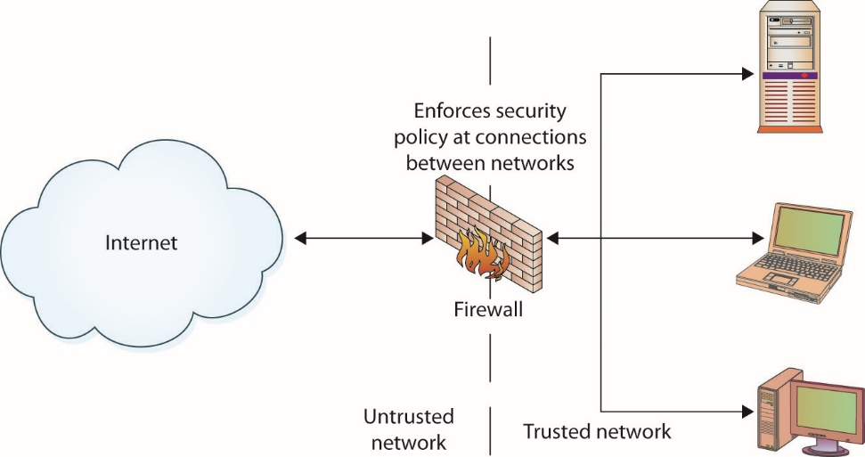
Figure 10.5 Logical depiction of a firewall protecting an organization from the Internet
Notes:
At a minimum, the corporate connection to the Internet should pass through a firewall, as shown in this figure. This firewall should block all network traffic except that specifically authorized by the security policy. This is actually easy to do: blocking communications on a port is simply a matter of telling the firewall to close the port. The issue comes in deciding what services are needed and by whom, and thus which ports should be open and which should be closed. This is what makes a security policy useful but, in some cases, difficult to maintain.

Slide 34
How Do Firewalls Work?
Firewalls enforce the established security policies through a variety of mechanisms, including:
Network Address Translation (NAT)
Basic packet filtering
Stateful packet filtering
Access control lists (ACLs)
Application layer proxies
ACLs are a cornerstone of security in firewalls.
Firewalls can also act as network traffic regulators.
Notes:
Firewalls enforce the established security policies. They can do this through a variety of mechanisms, including
Network Address Translation (NAT) – NAT translates private (nonroutable) IP addresses into public (routable) IP addresses.
Basic packet filtering – Basic packet filtering looks at each packet entering or leaving the network and then either accepts the packet or rejects the packet based on user-defined rules. Each packet is examined separately.
Stateful packet filtering – Stateful packet filtering also looks at each packet, but it can examine the packet in its relation to other packets. Stateful firewalls keep track of network connections and can apply slightly different rule sets based on whether the packet is part of an established session or not.
Access control lists (ACLs) – ACLs are simple rule sets that are applied to port numbers and IP addresses. They can be configured for inbound and outbound traffic and are most commonly used on routers and switches.
Application layer proxies – An application layer proxy can examine the content of the traffic as well as the ports and IP addresses. For example, an application layer has the ability to look inside a user’s web traffic, detect a malicious web site attempting to download malware to the user’s system, and block the malware.
As they are in routers, switches, servers, and other network devices, ACLs are a cornerstone of security in firewalls. Just as you must protect the device from physical access, ACLs do the same task for electronic access. Firewalls can extend the concept of ACLs by enforcing them at a packet level when packet-level stateful filtering is performed. This can add an extra layer of protection, making it more difficult for an outside hacker to breach a firewall.
Firewalls can also act as network traffic regulators in that they can be configured to mitigate specific types of network-based attacks. In denial-of-service and distributed denial-of-service attacks, an attacker can attempt to flood a network with traffic. Firewalls can be tuned to detect these types of attacks and act as flood guards, mitigating the effect on the network.

Slide 35
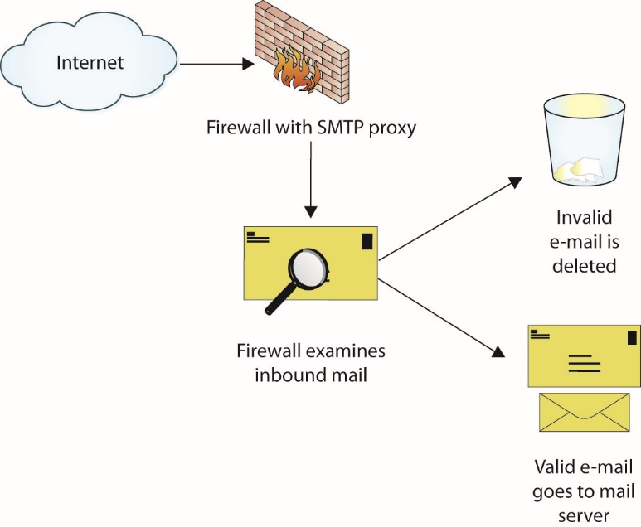
Figure 10.6 Firewall with SMTP application layer proxy
Notes:
Some high-security firewalls also employ application layer proxies. As the name implies, packets are not allowed to traverse the firewall, but data instead flows up to an application that in turn decides what to do with it. For example, an SMTP proxy may accept inbound mail from the Internet and forward it to the internal corporate mail server, as depicted in this figure.
While proxies provide a high level of security by making it very difficult for an attacker to manipulate the actual packets arriving at the destination, and while they provide the opportunity for an application to interpret the data prior to forwarding it to the destination, they generally are not capable of the same throughput as stateful packet-inspection firewalls. The trade-off between performance and speed is a common one and must be evaluated with respect to security needs and performance requirements.

Slide 36
Next-Generation Firewalls
Next-generation firewalls are characterized by these features:
Deep packet inspection
Move beyond port/protocol inspection and blocking
Add application-level inspection
Add intrusion prevention
Bring intelligence from outside the firewall
Traffic can be managed based on content, not merely site or URL.
Notes:
Firewalls operate by inspecting packets and by using rules associated with IP addresses and ports. Next-generation firewalls have significantly more
capability and are characterized by these features:
Deep packet inspection
Move beyond port/protocol inspection and blocking
Add application-level inspection
Add intrusion prevention
Bring intelligence from outside the firewall
Next-generation firewalls are more than just a firewall and IDS coupled together; they offer a deeper look at what the network traffic represents. In a legacy firewall, with port 80 open, all web traffic is allowed to pass. Using a next-generation firewall, traffic over port 80 can be separated by web site, or even activity on a web site (for example, allow Facebook, but not games on Facebook). Because of the deeper packet inspection and the ability to create rules based on content, traffic can be managed based on content, not merely site or URL.

Slide 37
Web Application Firewalls vs. Network Firewalls
A web application firewall is the term given to any software package, appliance, or filter that applies a rule set to HTTP/HTTPS traffic.
They shape web traffic and filter out SQL injection attacks, malware, cross-site scripting (XSS), and so on.
A network firewall is a hardware or software package that controls the flow of packets into and out of a network.
Notes:
Increasingly, the term “firewall” is getting attached to any device or software package that is used to control the flow of packets or data into or out of an organization.
Web application firewalls operate on traffic at a much higher level than network firewalls, as web application firewalls must be able to decode the web traffic to determine whether or not it is malicious.
Network firewalls operate on much simpler aspects of network traffic such as source/destination port and source/destination address.

Slide 38
Concentrators
Network devices called concentrators act as traffic management devices, managing flows from multiple points into single streams.
Concentrators typically act as endpoints for a particular protocol, such as SSL/TLS or VPN.
The use of specialized hardware can enable hardware-based encryption and provide a higher level of specific service than a general-purpose server.
This provides both architectural and functional efficiencies.

Slide 39
Wireless Devices
Wireless devices bring additional security concerns.
Radio waves or infrared carry data, which allows anyone within range access to the data.
The point of entry from a wireless device to a wired network is performed at a device called a wireless access point.
They can support multiple concurrent devices accessing network resources through the network node they create.
Several mechanisms can be used to add wireless functionality to a machine.
Notes:
Placing a wireless device behind a firewall does not do any good, because the firewall stops only physically connected traffic from reaching the device. Outside traffic can come literally from the parking lot directly to the wireless device and into the network.
Several mechanisms can be used to add wireless functionality to a machine. For PCs, this can be done via an expansion card. For notebooks, a PCMCIA adapter for wireless networks is available from several vendors. For both PCs and notebooks, vendors have introduced USB-based wireless connectors. The following illustration shows one vendor’s card—note the extended length used as an antenna. Not all cards have the same configuration, although they all perform the same function: to enable a wireless network connection. The numerous wireless protocols (802.11a, b, g, i, and n) are covered in Chapter 12. Wireless access points and cards must be matched by protocol for proper operation.

Slide 40
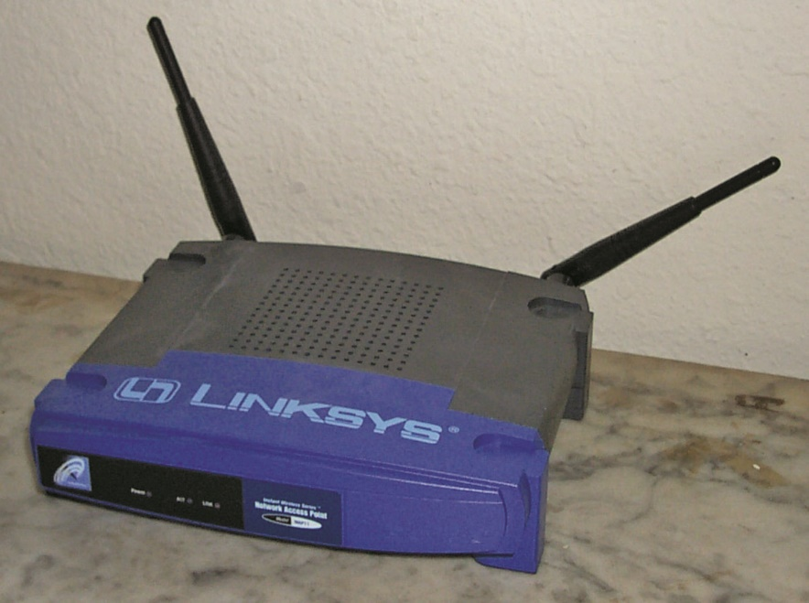
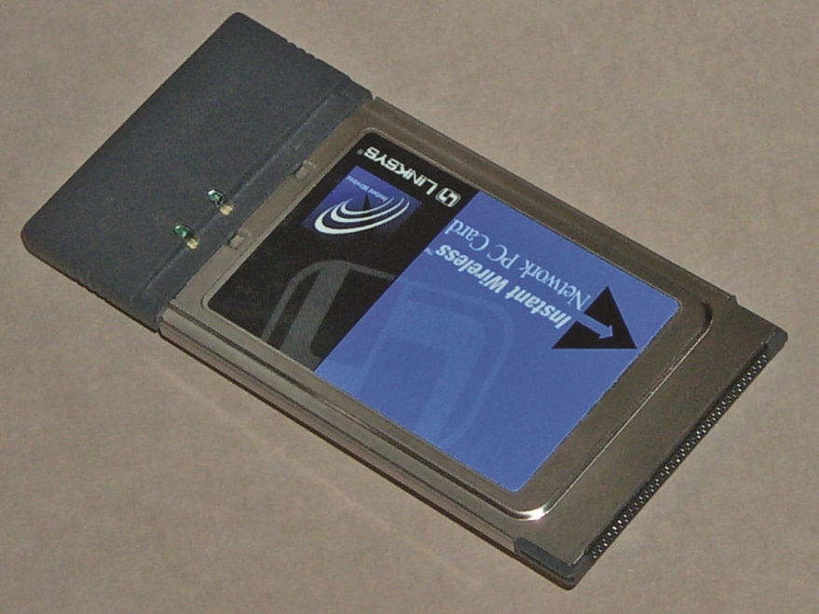
A typical wireless access point
A typical PCMCIA wireless network card

Slide 41
Modems
Modem is a shortened form of modulator/demodulator, converting analog signals to digital and vice versa.
A DSL modem is a device connected to special digital telephone lines using a direct connection.
A cable modem is a device connected to cable television lines set up in shared arrangements.
DOCSIS includes built-in support for security protocols.
Both DSL and cable are designed for a continuous connection.
Notes:
Although DSL modems are not actually modems in the true sense of the word, the term has stuck through marketing efforts directed to consumers. DSL and cable modems offer broadband high-speed connections and the opportunity for continuous connections to the Internet. Along with these new desirable characteristics come some undesirable ones, however. Although they both provide the same type of service, cable and DSL modems have some differences. A DSL modem provides a direct connection between a subscriber’s computer and an Internet connection at the local telephone company’s switching station. This private connection offers a degree of security, as it does not involve others sharing the circuit.
Cable modems are set up in shared arrangements that theoretically could allow a neighbor to sniff a user’s cable modem traffic. Cable modems were designed to share a party line in the terminal signal area, and the cable modem standard, Data Over Cable Service Interface Specification (DOCSIS), was designed to accommodate this concept. DOCSIS includes built-in support for security protocols, including authentication and packet filtering. Although this does not guarantee privacy, it prevents ordinary subscribers from seeing others’ traffic without using specialized hardware.
Both cable and DSL services are designed for a continuous connection, which brings up the question of IP address life for a client. Although some services originally used a static IP arrangement, virtually all have now adopted the Dynamic Host Configuration Protocol (DHCP) to manage their address space. A static IP address has an advantage of remaining the same and enabling convenient DNS connections for outside users. As cable and DSL services are primarily designed for client services as opposed to host services, this is not a relevant issue. A security issue of a static IP address is that it is a stationary target for hackers. The move to DHCP has not significantly lessened this threat, however, because the typical IP lease on a cable modem DHCP server is for days. This is still relatively stationary, and some form of firewall protection needs to be employed by the user.

Slide 42
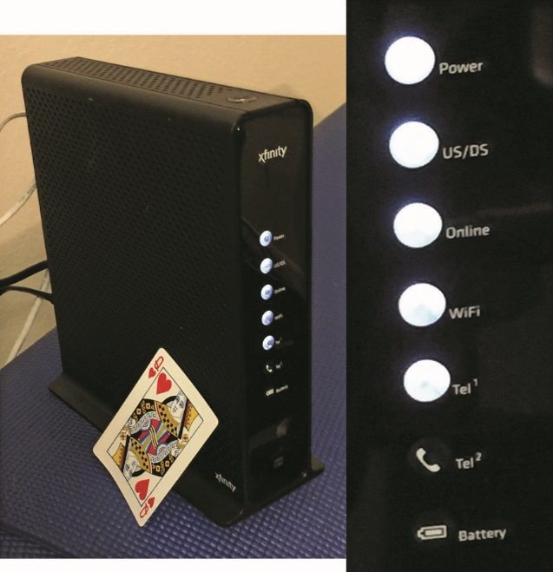
Figure 10.7 Modern cable modem
Notes:
This figure is a modern cable modem. It has an imbedded wireless access point, a VoIP connection, a local router, and DHCP server. The size of the device is fairly large, but it has a built-in lead-acid battery to provide VoIP service when power is out.

Slide 43
Modems (continued)
Security is needed with a cable/DSL connection.
The modem equipment provided by the subscription service converts the cable or DSL signal into a standard Ethernet signal that can then be connected to a NIC on the client device.
This is still just a direct network connection, with no security device separating the two.
The most common security device used in cable/DSL connections is a router that acts as a hardware firewall.
The firewall/router needs to be installed between the cable/DSL modem and client computers.

Slide 44
Telephony
A private branch exchange (PBX) is an extension of the public telephone network into a business.
The following are security concerns:
They can be compromised from the outside and used by phone hackers (phreakers) to make phone calls at the business’s expense.
A path exists for a connection to outside data networks and the Internet.
A firewall is needed for security on these connections.

Slide 45
VPN Concentrator
A virtual private network (VPN) is a construct used to provide a secure communication channel between users across public networks such as the Internet.
The most common implementation of VPN is via IPsec, a protocol for IP security.
IPsec is mandated in IPv6 and is optional in IPv4.
IPsec can be implemented in hardware, software, or a combination of both and is used to encrypt all IP traffic.
The use of encryption technologies allows either the data in a packet to be encrypted or the entire packet to be encrypted.
Notes:
Exam Tip: A VPN concentrator is a hardware device designed to act as a VPN endpoint, managing VPN connections to an enterprise.
The use of encryption technologies allows either the data in a packet to be encrypted or the entire packet to be encrypted. If the data is encrypted, the packet header can still be sniffed and observed between source and destination, but the encryption protects the contents of the packet from inspection. If the entire packet is encrypted, it is then placed into another packet and sent via tunnel across the public network. Tunneling can protect even the identity of the communicating parties.

Slide 46
Security Devices
There are a range of security devices that can be employed at the network layer to instantiate security functionality in the network layer.
Devices can be used for intrusion detection, network access control, and a wide range of other security functions.
Each device has a specific network function and plays a role in maintaining network infrastructure security.

Slide 47
Intrusion Detection Systems
Intrusion detection systems (IDSs) are designed to detect, log, and respond to unauthorized network or host use, both in real time and after the fact.
These systems are implemented using software.
In large networks or systems with significant traffic levels, dedicated hardware is typically required as well.
IDSs can be divided into two categories:
Network-based systems and host-based systems

Slide 48
Network Access Control
Managing endpoints on a case-by-case basis as they connect is a security methodology known as network access control.
Two main competing methodologies are:
Network Access Protection (NAP) – Microsoft
Measures the health of a host when it connects to the network
Network Admission Control (NAC) – Cisco
Enforces policies chosen by the network administrator
Both are still in early stages of implementation.

Slide 49
Network Monitoring/Diagnostic
The network operations center (NOC) allows operators to observe and interact with the network, using the self-reporting and, in some cases, self-healing nature of network devices to ensure efficient network operation.
Software enables controllers at NOCs to measure the actual performance of network devices and make changes to the configuration and operation of devices remotely.
SNMP was developed to perform management, monitoring, and fault resolution across networks.
Notes:
A computer network itself can be considered a large computer system, with performance and operating issues. Just as a computer needs management, monitoring, and fault resolution, so do networks. SNMP was developed to perform this function across networks. The idea is to enable a central monitoring and control center to maintain, configure, and repair network devices, such as switches and routers, as well as other network services, such as firewalls, IDSs, and remote access servers. SNMP has some security limitations, and many vendors have developed software solutions that sit on top of SNMP to provide better security and better management tool suites.
The concept of a network operations center (NOC) comes from the old phone company network days, when central monitoring centers monitored the health of the telephone network and provided interfaces for maintenance and management. This same concept works well with computer networks, and companies with midsize and larger networks employ the same philosophy. The NOC allows operators to observe and interact with the network, using the self-reporting and, in some cases, self-healing nature of network devices to ensure efficient network operation. Although generally a boring operation under normal conditions, when things start to go wrong, as in the case of a virus or worm attack, the NOC can become a busy and stressful place as operators attempt to return the system to full efficiency while not interrupting existing traffic.
SNMP is the main standard embraced by vendors to permit interoperability. Although SNMP has received a lot of security-related attention of late due to various security holes in its implementation, it is still an important part of a security solution associated with network infrastructure. Many useful tools have security issues; the key is to understand the limitations and to use the tools within correct boundaries to limit the risk associated with the vulnerabilities. Blind use of any technology will result in increased risk, and SNMP is no exception. Proper planning, setup, and deployment can limit exposure to vulnerabilities. Continuous auditing and maintenance of systems with the latest patches is a necessary part of operations and is essential to maintaining a secure posture.

Slide 50
Load Balancers
Load balancers are designed to distribute the processing load over two or more systems.
They are used to help improve resource utilization and throughput but also have the added advantage of increasing the fault tolerance of the overall system since a critical process may be split across several systems.
Should any one system fail, the others can pick up the processing it was handling.

Slide 51
Proxies
A proxy server (or simply proxy) can be used to filter out undesirable traffic and prevent employees from accessing potentially hostile web sites.
Proxy servers can be completely transparent (gateways or tunneling proxies), or a proxy server can modify the client request before sending it on, or even serve the client’s request without needing to contact the destination server.
Several major categories of proxy servers are in use.
Notes:
Proxies serve to manage connections between systems, acting as relays for the traffic. Proxies can function at the circuit level, where they support multiple traffic types, or they can be application-level proxies, which are designed to relay specific application traffic. An HTTP proxy can manage an HTTP conversation as it understands the type and function of the content. Application-specific proxies can serve as security devices if they are programmed with specific rules designed to provide protection against undesired content.
Several major categories of proxy servers are in use:
Anonymizing proxy – An anonymizing proxy is designed to hide information about the requesting system and make a user’s web browsing experience “anonymous.” This type of proxy service is often used by individuals who are concerned about the amount of personal information being transferred across the Internet and the use of tracking cookies and other mechanisms to track browsing activity.
Caching proxy – This type of proxy keeps local copies of popular client requests and is often used in large organizations to reduce bandwidth usage and increase performance. When a request is made, the proxy server first checks to see whether it has a current copy of the requested content in the cache; if it does, it services the client request immediately without having to contact the destination server. If the content is old or the caching proxy does not have a copy of the requested content, the request is forwarded to the destination server.
Content-filtering proxy – Content-filtering proxies examine each client request and compare it to an established acceptable use policy (AUP). Requests can usually be filtered in a variety of ways, including by the requested URL, destination system, or domain name or by keywords in the content itself. Content-filtering proxies typically support user-level authentication, so access can be controlled and monitored and activity through the proxy can be logged and analyzed. This type of proxy is very popular in schools, corporate environments, and government networks.
Open proxy – An open proxy is essentially a proxy that is available to any Internet user and often has some anonymizing capabilities as well. This type of proxy has been the subject of some controversy, with advocates for Internet privacy and freedom on one side of the argument, and law enforcement, corporations, and government entities on the other side. As open proxies are often used to circumvent corporate proxies, many corporations attempt to block the use of open proxies by their employees.
Reverse proxy – A reverse proxy is typically installed on the server side of a network connection, often in front of a group of web servers. The reverse proxy intercepts all incoming web requests and can perform a number of functions, including traffic filtering and shaping, SSL decryption, serving of common static content such as graphics, and performing load balancing.
Web proxy – A web proxy is solely designed to handle web traffic and is sometimes called a web cache. Most web proxies are essentially specialized caching proxies.
Deploying a proxy solution within a network environment is usually done either by setting up the proxy and requiring all client systems to configure their browsers to use the proxy or by deploying an intercepting proxy that actively intercepts all requests without requiring client-side configuration.
From a security perspective, proxies are most useful in their ability to control and filter outbound requests. By limiting the types of content and web sites employees can access from corporate systems, many administrators hope to avoid loss of corporate data, hijacked systems, and infections from malicious web sites. Administrators also use proxies to enforce corporate AUPs and track use of corporate resources. Most proxies can be configured to either allow or require individual user authentication—this gives them the ability to log and control activity based on specific users or groups. For example, an organization might want to allow the human resources group to browse Facebook during business hours but not allow the rest of the organization to do so.

Slide 52
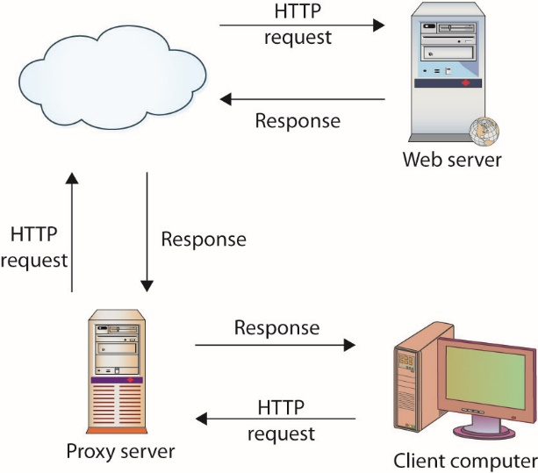
Figure 10.8 HTTP proxy handling client requests and web server responses
Notes:
A proxy server takes requests from a client system and forwards them to the destination server on behalf of the client, as shown in this figure.

Slide 53
Web Security Gateways
Some security vendors combine proxy functions with content-filtering functions to create a product called a web security gateway.
They are intended to address the security threats and pitfalls unique to web-based traffic.
Web security gateways capabilities include:
Real-time malware protection
Content monitoring
Productivity monitoring
Data protection and compliance
Notes:
Some security vendors combine proxy functions with content-filtering functions to create a product called a web security gateway. Web security gateways are intended to address the security threats and pitfalls unique to web-based traffic. Web security gateways typically provide the following capabilities:
Real-time malware protection (a.k.a. malware inspection) The ability to scan all outgoing and incoming web traffic to detect and block undesirable traffic such as malware, spyware, adware, malicious scripts, file-based attacks, and so on.
Content monitoring The ability to monitor the content of web traffic being examined to ensure that it complies with organizational policies.
Productivity monitoring The ability to measure types and quantities of web traffic that is being generated by specific users, groups of users, or the entire organization.
Data protection and compliance Scanning web traffic for sensitive or proprietary information being sent outside of the organization as well as the use of social network sites or inappropriate sites.

Slide 54
Internet Content Filters
An Internet content filter protects a corporation from employees’ viewing of inappropriate or illegal content at the workplace and the subsequent complications that occur when such viewing takes place.
They filter undesirable content, such as pornography and malicious activity such as browser hijacking attempts or XSS attacks.
Content-filtering systems face many challenges.
Notes:
Content-filtering systems face many challenges, because the ever changing Internet makes it difficult to maintain lists of undesirable sites (sometime called black lists); terms used on a medical site can also be used on a pornographic site, making keyword filtering challenging; and determined users are always seeking ways to bypass proxy filters. To help administrators, most commercial content-filtering solutions provide an update service, much like IDS or antivirus products that updates keywords and undesirable sites automatically.

Slide 55
Data Loss Prevention
Data loss prevention (DLP) refers to technology employed to detect and prevent transfers of data across an enterprise.
DLP technology can scan packets for specific data patterns.
DLP can be tuned to detect account numbers, secrets, specific markers, or files.
The primary challenge is the placement of the sensor.
The DLP sensor needs to be able observe the data, so if the channel is encrypted, DLP technology can be thwarted.

Slide 56
Unified Threat Management
A unified threat management (UTM) appliance refers to the “all-in-one security appliances,” many vendors offer that are devices that combine multiple functions into the same hardware appliance.
Most commonly these functions are firewall, IDS/IPS, and antivirus, although all-in-one appliances can include VPN capabilities, antispam, malicious web traffic filtering, antispyware, content filtering, traffic shaping, and so on.
A UTM simplifies the security activity as a single task, under a common software package for operations.
Notes:
Using a UTM solution simplifies the security activity as a single task, under a common software package for operations. This reduces the learning curve to a single tool rather than a collection of tools. A UTM solution can have better integration and efficiencies in handling network traffic and incidents than a collection of tools connected together.

Slide 57
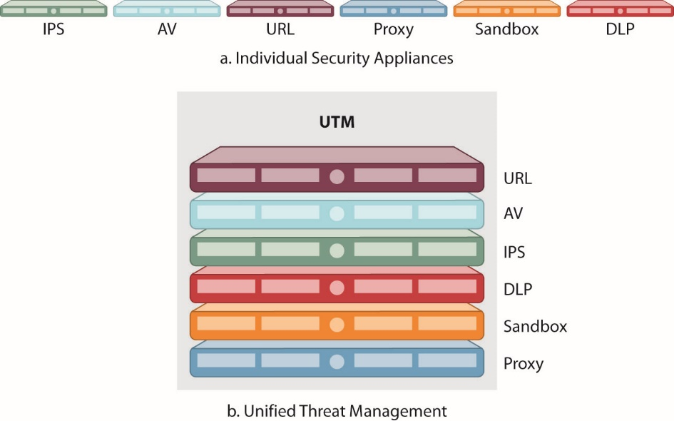
Figure 10.9 Unified threat management architecture
Notes:
This figure illustrates the advantages of UTM processing. Rather than processing elements in a linear fashion, as shown in 10.9a, the packets are processed in a parallelized fashion (b). There is a need to coordinate between the elements and many modern solutions do this with parallelized hardware.

Slide 58
Unified Threat Management (continued)
URL filters block connections to web sites that are in a prohibited list.
Content inspection is used to filter web requests that return content with specific components, such as names of body parts, music or video content, and other content that is inappropriate for the business environment.
UTM appliances can be tuned to detect malware.

Slide 59
Module 7 Infrastructure security and wireless security Part 2

Slide 60
Media
Four common methods are used to connect equipment at the physical layer:
Coaxial cable
Twisted-pair cable
Fiber-optics
Wireless
Notes:
The base of communications between devices is the physical layer of the OSI model. This is the domain of the actual connection between devices, whether by wire, fiber, or radio frequency waves. The physical layer separates the definitions and protocols required to transmit the signal physically between boxes from higher-level protocols that deal with the details of the data itself. Four common methods are used to connect equipment at the physical layer:
Coaxial cable
Twisted-pair cable
Fiber-optics
Wireless

Slide 61
Coaxial Cable
Coaxial cable has high bandwidth and shielding capabilities.
Compared to standard twisted pair lines, coaxial cable (“coax”) is much less prone to outside interference.
It is much more expensive to run.
It was an original design specification for Ethernet connections.
Today, Ethernet specifications use faster, cheaper twisted-pair alternatives.
“Vampire tap” security risk exists by drilling hole through the outer part of a coax cable.
Notes:
Coaxial cable is familiar to many households as a method of connecting televisions to VCRs or to satellite or cable services. It is used because of its high bandwidth and shielding capabilities. Compared to standard twisted pair lines such as telephone lines, coaxial cable (“coax”) is much less prone to outside interference. It is also much more expensive to run, both from a cost-per-foot measure and from a cable-dimension measure. Coax costs much more per foot than standard twisted-pair wires and carries only a single circuit for a large wire diameter.
An original design specification for Ethernet connections, coax was used from machine to machine in early Ethernet implementations. The connectors were easy to use and ensured good connections, and the limited distance of most office LANs did not carry a large cost penalty. Today, almost all of this older Ethernet specification has been replaced by faster, cheaper twisted-pair alternatives, and the only place you’re likely to see coax in a data network is from the cable box to the cable modem.
Because of its physical nature, it is possible to drill a hole through the outer part of a coax cable and connect to the center connector. This is called a “vampire tap” and is an easy method to get access to the signal and data being transmitted.

Slide 62
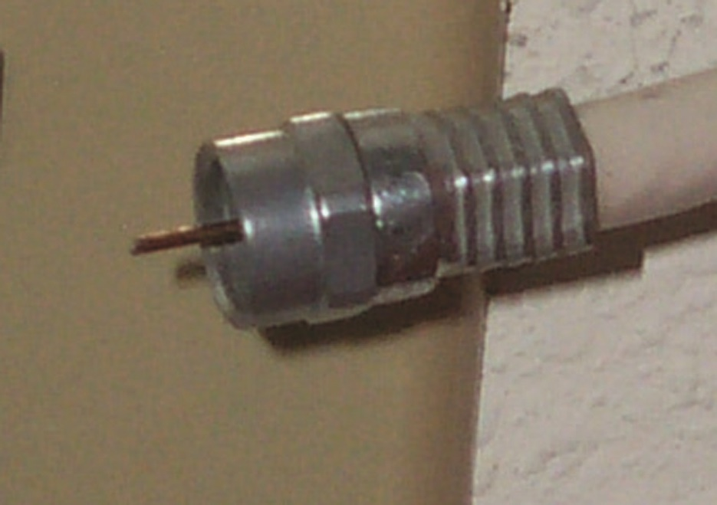
A coax connector

Slide 63
UTP/STP
Shielded twisted-pair (STP) has a foil shield around the pairs to provide extra shielding from electromagnetic interference.
Unshielded twisted-pair (UTP) relies on the twist to eliminate interference.
UTP has a cost advantage over STP.
Categories include Cat 3, Cat 5/Cat 5e, Cat 6/Cat 6a.
The standard method for connecting twisted-pair cables is via an 8-pin connector, called an RJ-45 connector.
Notes:
Twisted-pair wires have all but completely replaced coaxial cables in Ethernet networks. Twisted-pair wires use the same technology used by the phone company for the movement of electrical signals. Single pairs of twisted wires reduce electrical crosstalk and electromagnetic interference. Multiple groups of twisted pairs can then be bundled together in common groups and easily wired between devices.
Twisted pairs come in two types, shielded and unshielded. Shielded twisted-pair (STP) has a foil shield around the pairs to provide extra shielding from electromagnetic interference. Unshielded twisted-pair (UTP) relies on the twist to eliminate interference. UTP has a cost advantage over STP and is usually sufficient for connections, except in very noisy electrical areas.
Twisted-pair lines are categorized by the level of data transmission they can support. Three current categories are in use:
Category 3 (Cat 3) – Minimum for voice and 10-Mbps Ethernet.
Category 5 (Cat 5/Cat 5e) – For 100-Mbps Fast Ethernet; Cat 5e is an enhanced version of the Cat 5 specification to address far-end crosstalk and is suitable for 1000 Mbps.
Category 6 (Cat 6/Cat 6a) – For 10-Gigabit Ethernet over short distances; Cat 6a is used for longer, up to 100m, 10-Gbps cables.
The standard method for connecting twisted-pair cables is via an 8-pin connector, called an RJ-45 connector that looks like a standard phone jack connector but is slightly larger. One nice aspect of twisted-pair cabling is that it’s easy to splice and change connectors. Many a network administrator has made Ethernet cables from stock Cat-5 wire, two connectors, and a crimping tool. This ease of connection is also a security issue; because twisted-pair cables are easy to splice into, rogue connections for sniffing could be made without detection in cable runs. Both coax and fiber are much more difficult to splice because each requires a tap to connect, and taps are easier to detect.

Slide 64
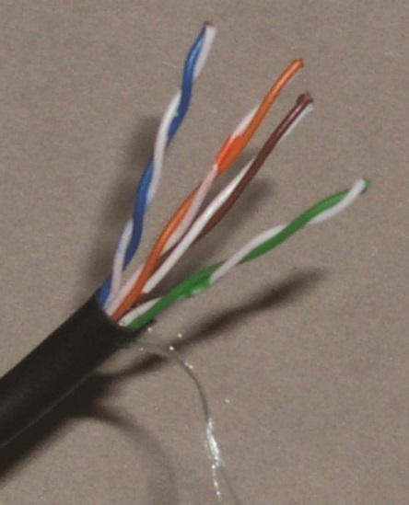
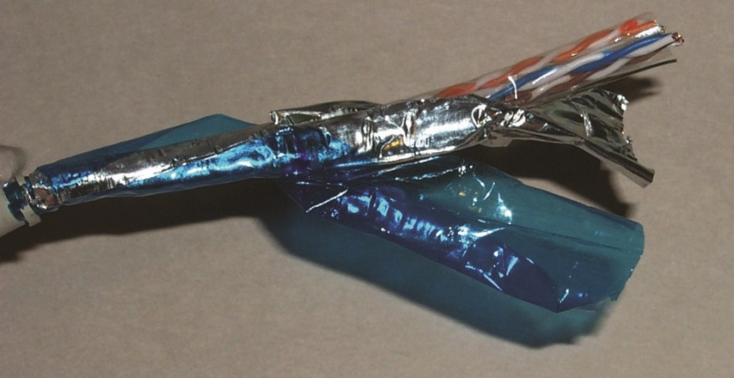
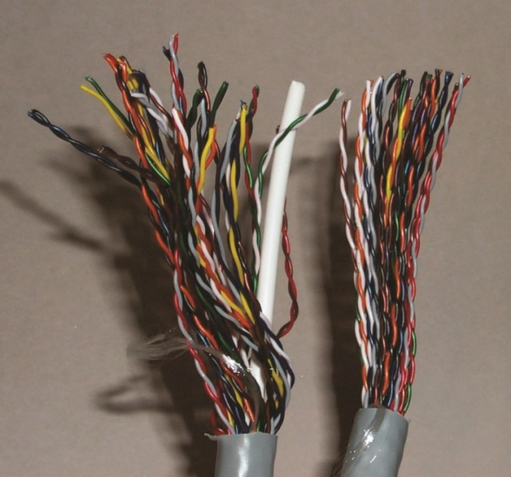
A typical 8-wire STP line
A typical 8-wire UTP line
A bundle of UTP wires

Slide 65
Fiber
Fiber-optic cable uses beams of laser light to connect devices over a thin glass wire.
The biggest advantage to fiber is its bandwidth.
Fiber has one major drawback—cost.
When measured by bandwidth, using fiber is cheaper than using competing wired technologies.
But connections to a fiber are difficult and expensive, and fiber is impossible to splice.
Cable companies use coax and DSL providers use twisted-pair to handle the “last mile” scenario.
Notes:
The biggest advantage to fiber is its bandwidth, with transmission capabilities into the terabits per second range. Fiberoptic cable is used to make high-speed connections between servers and is the backbone medium of the Internet and large networks.
The length of runs of fiber can be much longer, and the data capacity of fiber is much higher.
Splicing fiber is practically impossible; the solution is to add connectors and connect through a repeater. This adds to the security of fiber in that unauthorized connections are all but impossible to make. The high cost of connections to fiber and the higher cost of fiber per foot also make it less attractive for the final mile in public networks where users are connected to the public switching systems. For this reason, cable companies use coax and DSL providers use twisted-pair to handle the “last mile” scenario.

Slide 66
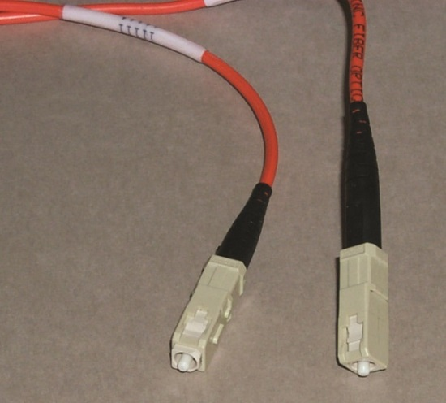
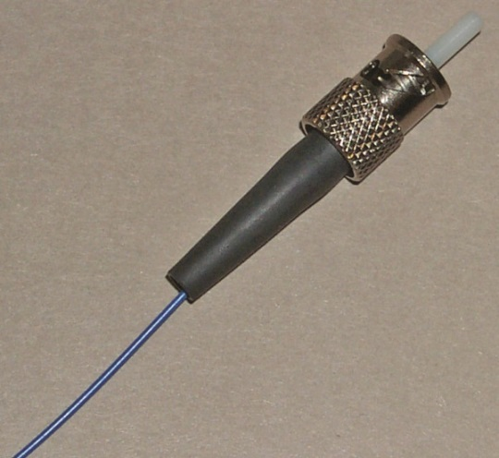
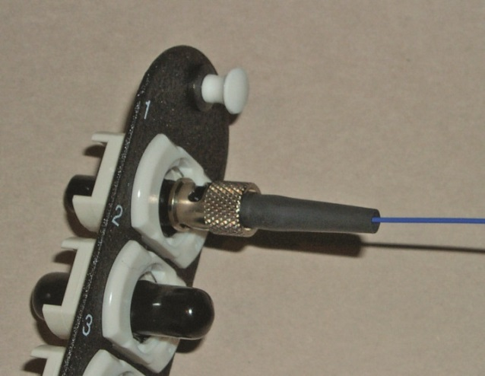
A type of fiber terminator
A typical fiber-optic fiber, terminator, and connector block
Notes:
Connections to a fiber are difficult and expensive, and fiber is impossible to splice. Making the precise connection on the end of a fiber-optic line is a highly skilled job and is done by specially trained professionals who maintain a level of proficiency. Once the connector is fitted on the end, several forms of connectors and blocks are used, as shown in the images.

Slide 67
Unguided Media
Unguided media is a phrase used to cover all transmission media not guided by wire, fiber, or other constraints.
It includes radio frequency, infrared, and microwave methods.
Unguided media have one attribute in common.
They are unguided and as such can travel to many machines simultaneously.
Must assume that unauthorized users have access to the signal.
Notes:
Transmission patterns can be modulated by antennas, but the target machine can be one of many in a reception zone. As such, security principles are even more critical, as they must assume that unauthorized users have access to the signal.

Slide 68
Unguided Media (continued)
Infrared (IR)
Infrared (IR) is a band of electromagnetic energy just beyond the red end of the visible color spectrum.
Today, IR seems to be everywhere.
IR can also be used to connect devices in a network configuration, but it is slow compared to other wireless technologies.
IR cannot penetrate walls but instead bounces off them.
Nor can it penetrate other solid objects; if you stack a few items in front of the transceiver, the signal is lost.
Notes:
IR has been used in remote-control devices for years. IR made its debut in computer networking as a wireless method to connect to printers. Now that wireless keyboards, wireless mice, and mobile devices exchange data via IR, it seems to be everywhere.

Slide 69
Unguided Media (continued)
RF/Microwave
RF waves are a common wireless communication method
Use a variety of frequency bands, each with special characteristics
Key features of microwave communications include:
Penetration of building structure
Broadcast capability
The “last mile” problem is the connection of individual consumers to a backbone, an expensive proposition because of the sheer number of connections and unshared line at this point in a network.

Slide 70
Removable Media
Moving storage media represents a security risk from a couple of angles.
The first is the potential loss of control over the data on the moving media.
Second is the risk of introducing unwanted items, such as a virus or a worm, when the media are attached back to a network.
Both of these issues can be remedied through policies and software.
The key is to ensure that the policies are enforced and the software is effective.

Slide 71
Magnetic Media
Magnetic media store data through the rearrangement of magnetic particles on a nonmagnetic substrate.
Common forms include hard drives, floppy disks, zip disks, and magnetic tape.
All these devices share some common characteristics:
Each has sensitivity to external magnetic fields.
They are also affected by high temperatures, as in fires, and by exposure to water.

Slide 72
Magnetic Media (continued)
Hard drives
Now they are small enough to attach to mobile devices.
A spinning platter rotates the magnetic media beneath heads that read the patterns in the oxide coating.
Capacities are growing.
Security control to help protect the confidentiality of the data is full drive encryption built into the drive hardware.
Using a key that is controlled, through a Trusted Platform Module (TPM) interface for instance, this technology protects the data if the drive itself is lost or stolen.
Notes:
Hard drives used to require large machines in mainframes. Now they are small enough to attach to mobile devices. The concepts remain the same among all of them: a spinning platter rotates the magnetic media beneath heads that read the patterns in the oxide coating. As drives have gotten smaller and rotation speeds have increased, the capacities have also grown. Today gigabytes of data can be stored in a device slightly larger than a bottle cap. Portable hard drives in the 1TB to 3TB range are now available and affordable.
One of the security controls available to help protect the confidentiality of the data is full drive encryption built into the drive hardware. Using a key that is controlled, through a Trusted Platform Module (TPM) interface for instance, this technology protects the data if the drive itself is lost or stolen. This may not be important if a thief takes the whole PC, but in larger storage environments, drives are placed in separate boxes and remotely accessed. In the specific case of notebook machines, this layer can be tied to smart card interfaces to provide more security. As this is built into the controller, encryption protocols such as Advanced Encryption Standard (AES) and Triple Data Encryption Standard (3DES) can be performed at full drive speed.

Slide 73
Magnetic Media (continued)
Diskettes
Floppy disks were the computer industry’s first attempt at portable magnetic media.
The movable medium was placed in a protective sleeve, and the drive remained in the machine.
Capacities up to 1.4MB were achieved, but the fragility of the device as the size increased, as well as competing media, has rendered floppies almost obsolete.
Diskettes are part of history now.

Slide 74
Magnetic Media (continued)
Tape
Its primary use has been bulk offline storage and backup.
The advantage of tape is low cost.
The disadvantage of tape is its nature as a serial access medium, making it slow to work with for large quantities of data.
Tapes are still a major concern from a security perspective, as they are used to back up many types of computer systems.
The physical protection afforded the tapes is of concern.
Notes:
Several types of magnetic tape are in use today, ranging from quarter inch to digital linear tape (DLT) and digital audio tape (DAT). These cartridges can hold upward of 60GB of compressed data.
Tapes are still a major concern from a security perspective, as they are used to back up many types of computer systems. The physical protection afforded the tapes is of concern, because if a tape is stolen, an unauthorized user could establish a network and recover your data on his system, because it’s all stored on the tape. Offsite storage is needed for proper disaster recovery protection, but secure offsite storage and transport is what is really needed. This important issue is frequently overlooked in many facilities. The simple solution to maintain control over the data even when you can’t control the tape is through encryption. Backup utilities can secure the backups with encryption, but this option is frequently not used, for a variety of reasons. Regardless of the rationale for not encrypting data, once a tape is lost, not using the encryption option becomes a lamented decision.

Slide 75

A magnetic tape cartridge for backups

Slide 76
Optical Media
Optical media involve the use of a laser to read data stored on a physical device.
A laser picks up deformities embedded in the media that contain the information.
As with magnetic media, optical media can be read-write, although the read-only version is still more common.

Slide 77
Optical Media (continued)
CD-R/DVD
They operate as optical storage, with little marks burned in them to represent 1’s and 0’s on a microscopic scale.
The most common type of CD is the read-only version.
A second-generation device, the recordable compact disc (CD-R), allows users to create their own CDs.
A newer type, CD-RW, has a different dye that allows discs to be erased and reused.
The cost of the media increases from CD, to CD-R, to CD-RW.
Notes:
The compact disc (CD) took the music industry by storm, and then it took the computer industry by storm as well. A standard CD holds more than 640MB of data, in some cases up to 800MB. The digital video disc (DVD) can hold almost 5GB of data single sided, 8.5GB dual layer. These devices operate as optical storage, with little marks burned in them to represent 1’s and 0’s on a microscopic scale. The most common type of CD is the read-only version, in which the data is written to the disc once and only read afterward. This has become a popular method for distributing computer software, although higher-capacity DVDs have replaced CDs for program distribution. A second-generation device, the recordable compact disc (CD-R), allows users to create their own CDs using a burner device in their PC and special software. Users can now back up data, make their own audio CDs, and use CDs as high-capacity storage. Their relatively low cost has made them economical to use. CDs have a thin layer of aluminum inside the plastic, upon which bumps are burned by the laser when recorded. CD-Rs use a reflective layer, such as gold, upon which a dye is placed that changes upon impact by the recording laser. A newer type, CD-RW, has a different dye that allows discs to be erased and reused. The cost of the media increases from CD, to CD-R, to CD-RW.

Slide 78
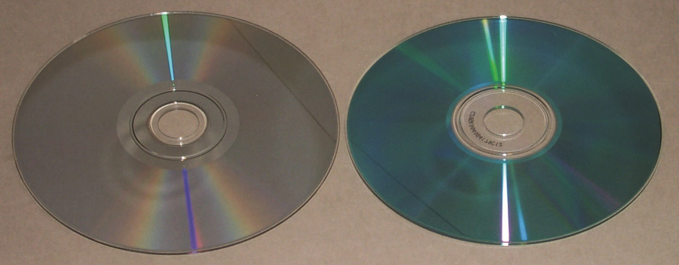
A DVD (left) and CD (right)

Slide 79
Optical Media (continued)
Blu-ray discs
The latest version of optical disc is the Blu-ray disc.
Using a smaller, violet-blue laser, this system can hold significantly more information than a DVD.
Blu-ray discs can hold up to 128 GB in four layers.
The transfer speed of Blu-ray at > 48 Mbps is over four times greater than that of DVD systems.
Designed for high-definition (HD) video, Blu-ray offers significant storage for data as well.
DVDs now occupy the same role that CDs have in the recent past.
Notes:
DVDs now occupy the same role that CDs have in the recent past, except that they hold more than seven times the data of a CD. This makes full-length movie recording possible on a single disc. The increased capacity comes from finer tolerances and the fact that DVDs can hold data on both sides. A wide range of formats for DVDs include DVD+R, DVD-R, dual layer, and now HD formats, HD-DVD and Blu-ray. This variety is due to competing “standards” and can result in confusion. DVD+R and -R are distinguishable only when recording, and most devices since 2004 should read both. Dual layers add additional space but require appropriate dual layer–enabled drives.

Slide 80
Electronic Media
The latest form of removable media is electronic memory.
Static memory which retains data even without power
Variety of vendor-specific types:
Smart cards, SmartMedia, SD cards, flash cards, memory sticks, and CompactFlash devices
Range from small card-like devices to USB sticks
Storage size ranges from 256MB to 64GB making them capable of carrying significant quantities of information
Notes:
The latest form of removable media is electronic memory. Electronic circuits of static memory, which can retain data even without power, fill a niche where high density and small size are needed.
Originally used in audio devices and digital cameras, these electronic media come in a variety of vendor-specific types, such as smart cards, SmartMedia, SD cards, flash cards, memory sticks, and CompactFlash devices.
These memory devices range from small card-like devices, of which microSD cards are smaller than dimes and hold 2GB, to USB sticks that hold up to 64GB.
These devices are becoming ubiquitous, with new PCs and netbooks containing built-in slots to read them like any other storage device.
Several recent photo-quality color printers have been released with ports to accept the cards directly, meaning that a computer is not required for printing.
Computer readers are also available to permit storing data from the card onto hard drives and other media in a computer.
The size of storage on these devices ranges from 256MB to 64GB making them capable of carrying significant quantities of information.

Slide 81
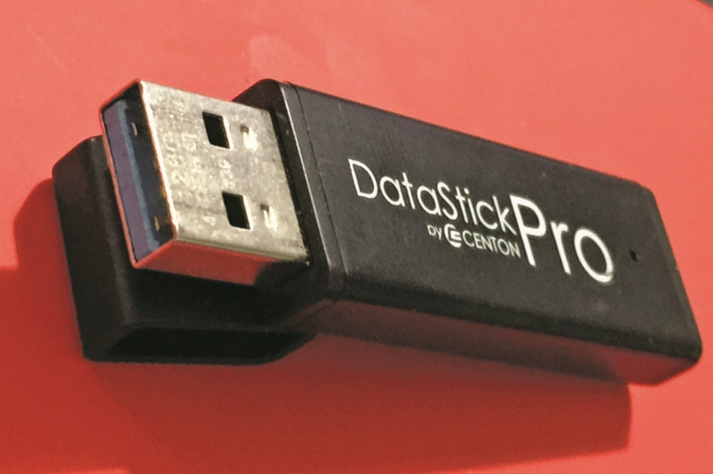
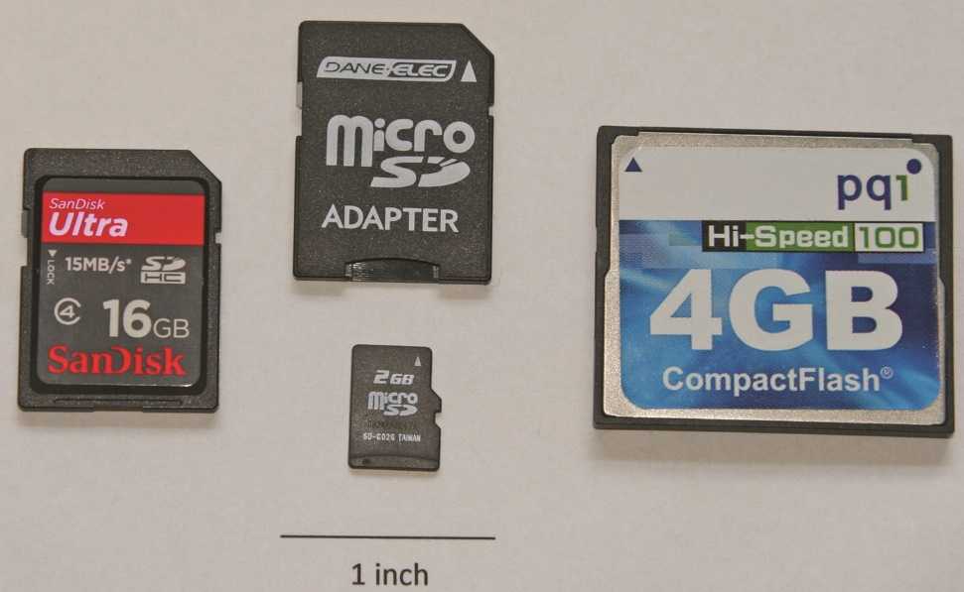
SD, microSD, and CompactFlash cards
128GB USB 3.0 memory stick

Slide 82
Electronic Media (continued)
Solid-state hard drives
With the rise of solid-state memory technologies comes a solid-state “hard drive.”
Solid-state drives (SSDs) are moving into mobile devices, desktops, and even servers.
Memory densities are significantly beyond physical drives, there are no moving parts to wear out or fail, and SSDs have vastly superior performance specifications.
The only factor that has slowed the spread of this technology has been cost, but recent cost reductions have made this form of memory a first choice in many systems.

Slide 83
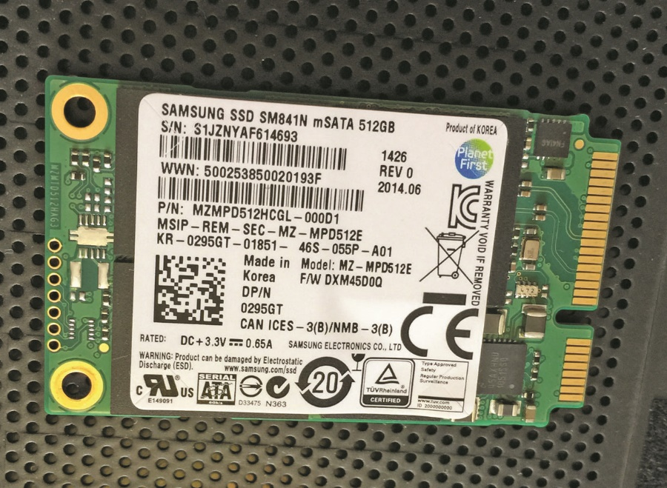
Figure 10.10 512GB solid-state half-height minicard
Notes:
This figure shows a 512GB SSD from a laptop, on a half-height minicard mSATA interface.

Slide 84
Security Concerns for Transmission Media
The primary security concern for a system administrator has to be preventing physical access to a server by an unauthorized individual.
One of the administrator’s next major concerns should be preventing unfettered access to a network connection.
Preventing such access is costly, yet the cost of replacing a server because of theft is also costly.
Notes:
The primary security concern for a system administrator has to be preventing physical access to a server by an unauthorized individual. Such access will almost always spell disaster, for with direct access and the correct tools, any system can be infiltrated. One of the administrator’s next major concerns should be preventing unfettered access to a network connection. Access to switches and routers is almost as bad as direct access to a server, and access to network connections would rank third in terms of worst-case scenarios. Preventing such access is costly, yet the cost of replacing a server because of theft is also costly.

Slide 85
Physical Security Concerns
A balanced approach is the most sensible approach when addressing physical security, and this applies to transmission media as well.
One of the keys to mounting a successful attack on a network is information.
Usernames, passwords, server locations—all of these can be obtained if someone has the ability to observe network traffic in a process called sniffing.
Many common scenarios exist when unauthorized entry to a network occurs.
Notes:
Keeping network switch rooms secure and cable runs secure seems obvious, but cases of using janitorial closets for this vital business purpose abound. One of the keys to mounting a successful attack on a network is information. Usernames, passwords, server locations—all of these can be obtained if someone has the ability to observe network traffic in a process called sniffing.
A sniffer can record all the network traffic, and this data can be mined for accounts, passwords, and traffic content, all of which can be useful to an unauthorized user. One starting point for many intrusions is the insertion of an unauthorized sniffer into the network, with the fruits of its labors driving the remaining unauthorized activities. Many common scenarios exist when unauthorized entry to a network occurs, including these:
Inserting a node and functionality that is not authorized on the network, such as a sniffer device or unauthorized wireless access point
Modifying firewall security policies
Modifying ACLs for firewalls, switches, or routers
Modifying network devices to echo traffic to an external node
Network devices and transmission media become targets because they are dispersed throughout an organization, and physical security of many dispersed items can be difficult to manage. Although limiting physical access is difficult, it is essential. The least level of skill is still more than sufficient to accomplish unauthorized entry into a network if physical access to the network signals is allowed. This is one factor driving many organizations to use fiber-optics, for these cables are much more difficult to tap. Although many tricks can be employed with switches and VLANs to increase security, it is still essential that you prevent unauthorized contact with the network equipment.

Slide 86
Physical Security Concerns (continued)
Although limiting physical access is difficult, it is essential.
Despite other measures, it is still essential that you prevent unauthorized contact with the network equipment.
To ensure that unauthorized traffic does not enter your network through a wireless access point, you must either use a firewall with an authentication system or establish a VPN.
Notes:
Network devices and transmission media become targets because they are dispersed throughout an organization, and physical security of many dispersed items can be difficult to manage. The least level of skill is still more than sufficient to accomplish unauthorized entry into a network if physical access to the network signals is allowed. This is one factor driving many organizations to use fiber-optics, for these cables are much more difficult to tap. Although many tricks can be employed with switches and VLANs to increase security, it is still essential that you prevent unauthorized contact with the network equipment.
Wireless networks make the intruder’s task even easier, as they take the network to the users, authorized or not. A technique called war-driving involves using a laptop and software to find wireless networks from outside the premises. A typical use of war-driving is to locate a wireless network with poor (or no) security and obtain free Internet access, but other uses can be more devastating. A simple solution is to place a firewall between the wireless access point and the rest of the network and authenticate users before allowing entry. Business users use VPN technology to secure their connection to the Internet and other resources, and home users can do the same thing to prevent neighbors from “sharing” their Internet connections. To ensure that unauthorized traffic does not enter your network through a wireless access point, you must either use a firewall with an authentication system or establish a VPN.

Slide 87
Cloud Computing
Cloud computing is a common term used to describe computer services provided over a network.
This includes computing, storage, applications, and services that are offered via the Internet Protocol.
One of the characteristics of cloud computing is transparency to the end user.
Security is a particular challenge when data and computation are handled by a remote party, as in cloud computing.
Clouds can be created by many entities, internal and external to an organization.
Notes:
One of the characteristics of cloud computing is transparency to the end user. This improves usability of this form of service provisioning. Cloud computing offers much to the user: improvements in performance, scalability, flexibility, security, and reliability, among other items. These improvements are a direct result of the specific attributes associated with how cloud services are implemented.
Security is a particular challenge when data and computation are handled by a remote party, as in cloud computing. The specific challenge is how does one allow data outside their enterprise and yet remain in control over how the data is used, and the common answer is encryption. By properly encrypting data before it leaves the enterprise, external storage can still be performed securely.
Clouds can be created by many entities, internal and external to an organization. Commercial cloud services are already available and offered by a variety of firms, as large as Google and Amazon, to smaller, local providers. Internal services can replicate the advantages of cloud computing while improving the utility of limited resources. The promise of cloud computing is improved utility and, as such, is marketed under the concepts of Software as a Service, Platform as a Service, and Infrastructure as a Service.

Slide 88
Private
If your organization is highly sensitive to sharing resources, you may wish to consider the use of a private cloud.
Private clouds are essentially reserved resources used only for your organization—your own little cloud within the cloud.
This service will be considerably more expensive, but it should also carry less exposure and should enable your organization to better define the security, processing, and handling of data that occurs within your cloud.

Slide 89
Public
The term public cloud refers to cloud service rendered over a system that is open for public use.
In most cases, there is little operational difference between public and private cloud architectures, but the security ramifications can be substantial.
Although public cloud services will separate users with security restrictions, the depth and level of these restrictions, by definition, will be significantly less in a public cloud.

Slide 90
Hybrid
A hybrid cloud structure is one where elements are combined from private, public, and community cloud structures.
When examining a hybrid structure, you need to remain cognizant that operationally these differing environments may not actually be joined, but rather used together.
Sensitive information can be stored in the private cloud and issue-related information can be stored in the community cloud, all of which information is accessed by an application.
This makes the overall system a hybrid cloud system.

Slide 91
Community
A community cloud system is one where several organizations with a common interest share a cloud environment for the specific purposes of the shared endeavor.
An example is local public entities and key local firms sharing a community cloud dedicated to serving the interests of community initiatives.
This can be an attractive cost-sharing mechanism for specific data-sharing initiatives.

Slide 92
Software as a Service
Software as a Service (SaaS) is the offering of software to end users from within the cloud.
Rather than installing software on client machines, SaaS acts as software on demand where the software runs from the cloud.
This has several advantages, as updates are often seamless to end users and integration between components is enhanced.

Slide 93
Platform as a Service
Platform as a Service (PaaS) is a marketing term used to describe the offering of a computing platform in the cloud.
Multiple sets of software, working together to provide services, such as database services, can be delivered via the cloud as a platform.

Slide 94
Infrastructure as a Service
Infrastructure as a Service (IaaS) is a term used to describe cloud-based systems that are delivered as a virtual platform for computing.
Rather than building data centers, IaaS allows firms to contract for utility computing as needed.

Slide 95
Chapter Summary
Construct networks using different types of network devices.
Enhance security using security devices.
Enhance security using NAC/NAP methodologies.
Identify the different types of media used to carry network signals.
Describe the different types of storage media used to store information.

Slide 96
Chapter Summary (continued)
Use basic terminology associated with network functions related to information security.
Describe the different types and uses of cloud computing.

Slide 97
Module 7 Infrastructure security and wireless security Part 3

Slide 98
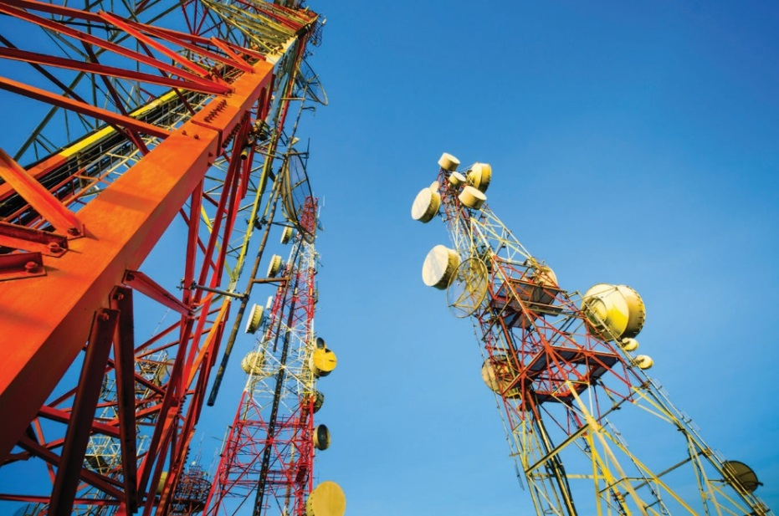
Wireless Security and Mobile Devices
Chapter 12

Slide 99
Objectives
Describe the different wireless systems in use today.
Detail WAP and its security implications.
Identify 802.11’s security issues and possible solutions.
Examine the elements needed for enterprise wireless deployment.
Examine the security of mobile systems.

Slide 100
Key Terms
2.4 GHz band
5 GHz band
Beacon frames
Bluebugging
Bluejacking
Bluesnarfing
Bluetooth DOS
Captive portal
Confidentiality
Direct-sequence spread spectrum (DSSS)
Evil twin
Geo-tagging
IEEE 802.1X
IEEE 802.11
Initialization vector (IV)
Notes:
2.4 GHz band – The same band used for 802.11.
5 GHz band – Allows faster speeds over shorter ranges.
Beacon frames – A series of frames used in WiFi (802.11) to establish the presence of a wireless network device.
Bluebugging – The use of a Bluetooth-enabled device to eavesdrop on another person’s conversation using that person’s Bluetooth phone as a transmitter. The bluebug application silently causes a Bluetooth device to make a phone call to another device, causing the phone to act as a transmitter and allowing the listener to eavesdrop on the victim’s conversation in real time.
Bluejacking – The sending of unsolicited messages over Bluetooth to Bluetooth-enabled devices such as mobile phones, tablets, or laptop computers.
Bluesnarfing – The unauthorized access of information from a Bluetooth-enabled device through a Bluetooth connection, often between phones, desktops, laptops, and tablets.
Bluetooth DOS – The use of Bluetooth technology to perform a denial-of-service attack against another device. In this attack, an attacker repeatedly requests pairing with the victim device. This type of attack does not divulge information or permit access, but is a nuisance. And, more importantly, if done repeatedly it can drain a device’s battery, or prevent other operations from occurring on the victim’s device.
Captive portal – A website used to validate credentials before allowing access to a network connection.
Confidentiality – Part of the CIA of security. Refers to the security principle that states that information should not be disclosed to unauthorized individuals.
Direct-sequence spread spectrum (DSSS) – A method of distributing a communication over multiple frequencies to avoid interference and detection.
Evil twin – A wireless attack performed using a second, rogue wireless access point designed to mimic a real access point.
Geo-tagging – The metadata that contains location-specific information that is attached to other data elements.
IEEE 802.1X – An IEEE standard for performing authentication over networks.
IEEE 802.11 – A family of standards that describe network protocols for wireless devices.
Initialization vector (IV) – A data value used to seed a cryptographic algorithm, providing for a measure of randomness.

Slide 101
Key Terms (continued)
Jailbreaking
MAC filtering
MIMO
Mobile device management (MDM)
Near field communication (NFC)
Orthogonal frequency division multiplexing (OFDM)
RC4 stream cipher
Remote wiping
Rogue access point
Screen locking
Notes:
Jailbreaking – The process of breaking OS security features designed to limit interactions with the OS itself. Commonly performed on mobile phones to unlock features or break locks to carriers.
MAC filtering – The use of layer 2 MAC addresses to filter traffic to only authorized NIC cards.
MIMO – A set of multiple-input and multiple-output antenna technologies where the available antennas are spread over a multitude of independent access points each having one or multiple antennas.
Mobile device management (MDM) – A marketing term for a collective set of commonly employed protection elements associated with mobile devices.
Near field communication (NFC) – A set of standards and protocols for establishing a communication link over very short distances. Used in mobile devices.
Orthogonal frequency division multiplexing (OFDM) – Multiplexes, or separates, the data to be transmitted into smaller chunks and then transmits the chunks on several subchannels. This use of subchannels is what the “frequency division” portion of the name refers to. Both of these techniques, multiplexing and frequency division, are used to avoid interference. Orthogonal refers to the manner in which the subchannels are assigned, principally to avoid crosstalk, or interference with your own channels.
RC4 stream cipher – A stream cipher used in TLS and WEP.
Remote wiping – An action that typically removes data stored on the device and resets the device to factory settings.
Rogue access point – An unauthorized access point inserted into a network allowing unauthorized wireless access.
Screen locking – A phone’s capability whereby one must enter a passcode or PIN to unlock the device. It is highly recommended that screen locks be enforced for all mobile devices.

Slide 102
Key Terms (continued)
Service set identifier (SSID)
Site survey
Temporal Key Integrity Protocol (TKIP)
WAP gap
Wi-Fi Protected Access 2 (WPA2)
Notes:
Service set identifier (SSID) – Identifies a specific 802.11 wireless network. It transmits information about the access point to which the wireless client is connecting.
Site survey – Involves several steps: mapping the floor plan, testing for RF interference, testing for RF coverage, and analysis of material via software.
Temporal Key Integrity Protocol (TKIP) – A security protocol used in 802.11 wireless networks.
WAP gap – Refers to the confidentiality of information where the two different networks meet on the WAP gateway.
Wi-Fi Protected Access 2 (WPA2) – A protocol to secure wireless communications using a subset of the 802.11i standard.

Slide 103
Introduction to Wireless Networking
Wireless networking is the transmission of packetized data by means of a physical topology that does not use direct physical links.
The IEEE 802.11 protocol has been standardized by the IEEE for wireless local area networks (LANs).
The Wireless Application Protocol (WAP) was one of the pioneers of mobile data applications.
Bluetooth is a short-range wireless protocol typically used on small devices such as mobile phones.
Notes:
The IEEE 802.11 protocol has been standardized by the IEEE for wireless local area networks (LANs). Three versions are currently in production—802.11g, 802.11a, and 802.11n. The latest standard is 802.11ac, but it provides backward compatibility with 802.11g hardware. Cellular phone technology has moved rapidly to embrace data transmission and the Internet.
The Wireless Application Protocol (WAP) was one of the pioneers of mobile data applications, but it has been overtaken by a variety of protocols pushing us to fourth-generation (4G) mobile networks.
Bluetooth is a short-range wireless protocol typically used on small devices such as mobile phones. Early versions of these phones also had Bluetooth on and discoverable as a default, making the compromise of a nearby phone easy. Security research has focused on finding problems with these devices simply because the devices are so common.

Slide 104
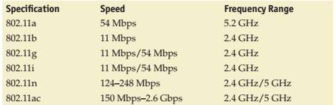
Notes:
Summary table of the 802.11 family

Slide 105
Introduction to Wireless Networking (continued)
Wireless is problematic from a security standpoint.
There are several different wireless bands in common use today.
Wi-Fi series refers to the 802.11 Wireless LAN standards certified by the Wi-Fi Alliance.
WiMAX refers to the set of 802.16 wireless network standards ratified by the WiMAX Forum.
ZigBee is a low-power, personal area networking technology described by the IEEE 802.15.4 series.
Notes:
Tech Tip: There are several different wireless bands in common use today, the most common of which is the Wi-Fi series, referring to the 802.11 Wireless LAN standards certified by the Wi-Fi Alliance. Another set of bands is WiMAX, which refers to the set of 802.16 wireless network standards ratified by the WiMAX Forum. Lastly, there is ZigBee, a lowpower, personal area networking technology described by the IEEE 802.15.4 series.

Slide 106
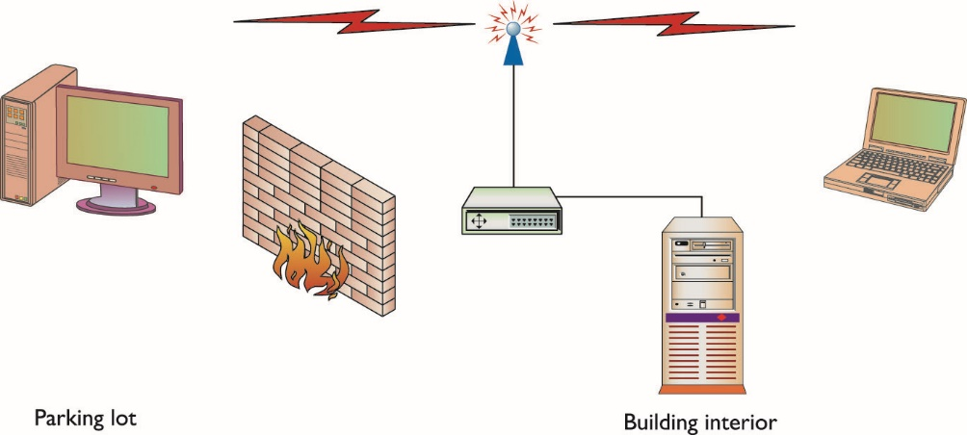
Figure 12.1 Wireless transmission extending beyond the facility’s walls
Notes:
If an attacker can get close enough to the signal’s source as it is being broadcast, he can at the very least listen to the access point and clients talking to capture all the packets for examination, as depicted in this figure.
Attackers can also try to modify the traffic being sent or try to send their own traffic to disrupt the system. In this chapter, you will learn about the different types of attacks that wireless networks face.

Slide 107
Mobile Phones
Today’s smartphones support multiple wireless data access methods.
This includes 802.11, Bluetooth, and cellular.
The Wireless Application Protocol (WAP) attempted to satisfy the needs for more data on mobile devices, but it is falling by the wayside as the mobile network capabilities increase.
The need for more and more bandwidth has pushed carriers to adopt a more IP-centric routing methodology.
Notes:
The need for more and more bandwidth has pushed carriers to adopt a more IP-centric routing methodology with technologies such as High Speed Packet Access (HSPA) and Evolution Data Optimized (EVDO). Mobile phones have ruthlessly advanced with new technologies and services, causing phones and the carrier networks that support them to be described in generations—1G, 2G, 3G, and 4G. 1G refers to the original analog cellular standard, Advanced Mobile Phone System (AMPS). 2G refers to the digital network that superseded it. 3G is the system of mobile networks that followed, with many different implementations carrying data at up to 400 Kbps. 4G represents the current state of mobile phones with LTE being the primary method. 4G allows carriers to offer a wider array of services to the consumer, including broadband data service up to 14.4 Mbps and video calling. 4G is also a move to an entirely IP-based network for all services, running voice over IP (VoIP) on your mobile phone and speeds up to 1 Gbps.
All of these “gee-whiz” features are nice, but how secure are your bits and bytes going to be when they’re traveling across a mobile carrier’s network? All the protocols mentioned have their own security implementations—WAP applies its own Wireless Transport Layer Security (WTLS) to attempt to secure data transmissions, but WAP still has issues such as the “WAP gap” (as discussed next). 3G networks have attempted to push a large amount of security down the stack and rely on the encryption designed into the wireless protocol.

Slide 108
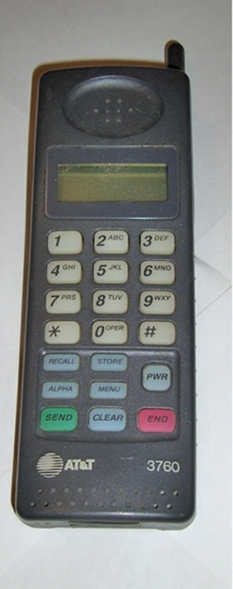
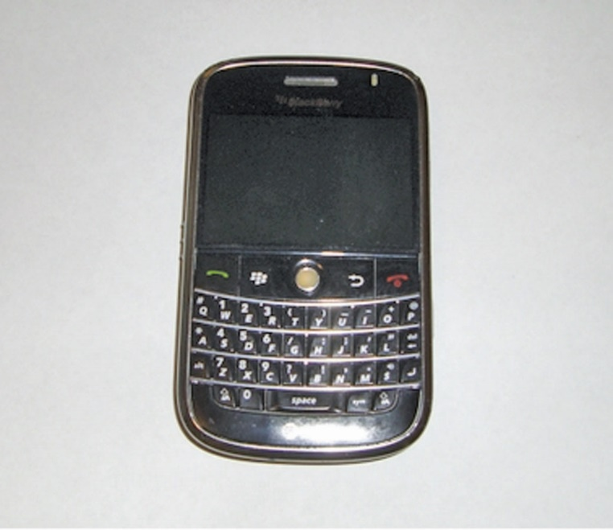
Early cell phones just allowed you to make calls.
Today’s phones allow you to carry computers in your pocket.
Notes:
When cellular phones first hit the market, security wasn’t an issue—if you wanted to keep your phone safe, you’d simply keep it physically secure and not loan it to people you didn’t want making calls. Its only function was that of a telephone.
The advance of digital circuitry has added amazing power in smaller and smaller devices, causing security to be an issue as the software becomes more and more complicated. Today’s small and inexpensive products have made the wireless market grow by leaps and bounds, as traditional wireless devices such as cellular phones and pagers have been replaced by tablets and smartphones.

Slide 109
Wireless Application Protocol
Wireless Transport Layer Security (WTLS) encryption scheme encrypts the plaintext data and then sends it over the airwaves as ciphertext.
The originator and the recipient both have keys to decrypt the data and reproduce the plaintext.
If the encryption is well designed and implemented, it is difficult for unauthorized users to take captured ciphertext and reproduce the plaintext that created it.
Confidentiality is the ability to keep protected data a secret.

Slide 110
Wireless Application Protocol (continued)
WTLS uses a modified version of the Transport Layer Security (TLS) protocol.
WTLS supports several bulk encryption algorithms.
WTLS implements integrity through the use of message authentication codes (MACs).
The TLS protocol that WTLS is based on is designed around Internet-based computers.
WTLS must cope with small amounts of memory and limited processor capacity.
Notes:
WTLS uses a modified version of the Transport Layer Security (TLS) protocol, which is the replacement for Secure Sockets Layer (SSL).
The WTLS protocol supports several popular bulk encryption algorithms, including Data Encryption Standard (DES), Triple DES (3DES), RC5, and International Data Encryption Algorithm (IDEA).
WTLS implements integrity through the use of message authentication codes (MACs). A MAC algorithm generates a one-way hash of the compressed WTLS data. WTLS supports the MD5 and SHA MAC algorithms. The MAC algorithm is also decided during the WTLS handshake. WTLS supports the MD5 and SHA MAC algorithms. The MAC algorithm is also decided during the WTLS handshake.
The TLS protocol that WTLS is based on is designed around Internet-based computers, machines that have relatively high processing power, large amounts of memory, and sufficient bandwidth available for Internet applications. Devices that WTLS must accommodate are limited in all these respects. Thus, WTLS has to be able to cope with small amounts of memory and limited processor capacity, as well as long round-trip times that TLS could not handle well. These requirements are the primary reasons that WTLS has security issues.

Slide 111
Wireless Application Protocol (continued)
The WTLS protocol is designed around more capable servers than devices and can allow connections with little to no security.
Clients with low memory or CPU capabilities cannot support encryption which greatly reduces confidentiality.
Authentication is optional and omitting it leaves the connection vulnerable to a man-in-the-middle–type attack.
General flaws in the protocol’s implementation exist.
Known security vulnerabilities include the chosen plaintext attack, the PKCS #1 attack, and the alert message truncation attack.

Slide 112
Wireless Application Protocol (continued)
The chosen-plaintext attack works on the principle of a predictable initialization vector (IV).
Concern over the WAP gap involves confidentiality of information where the two different networks meet the WAP gateway.
WTLS acts as the security protocol for the WAP network, and TLS is the standard for the Internet.
The WAP gateway has to perform translation from one encryption standard to the other.
Notes:
The chosen-plaintext attack works on the principle of a predictable initialization vector (IV). By the nature of the transport medium that it is using, WAP, WTLS needs to support unreliable transport. This forces the IV to be based on data already known to the client, and WTLS uses a linear IV computation. Because the IV is based on the sequence number of the packet, and several packets are sent unencrypted, entropy is severely decreased. This lack of entropy in the encrypted data reduces confidentiality.
Now consider the PKCS #1 attack. Public Key Cryptography Standards (PKCS), used in conjunction with RSA encryption, provide standards for formatting the padding used to generate a correctly formatted block size. When the client receives the block, it will reply to the sender as to the validity of the block. An attacker takes advantage of this by attempting to send multiple guesses at the padding to force a padding error. In vulnerable implementations, when RSA signatures and encryption are performed per PKCS #1, the RSA messages can be decrypted with approximately 220 chosen ciphertext queries. Alert messages in WTLS are sometimes sent in plaintext and are not authenticated. This fact could allow an attacker to overwrite an encrypted packet from the actual sender with a plaintext alert message, leading to possible disruption of the connection through, for instance, a truncation attack.
WTLS acts as the security protocol for the WAP network, and TLS is the standard for the Internet, so the WAP gateway has to perform translation from one encryption standard to the other. This translation forces all messages to be seen by the WAP gateway in plaintext. This is a weak point in the network design, but from an attacker’s perspective, it’s a much more difficult target than the WTLS protocol itself. Threats to the WAP gateway can be minimized through careful infrastructure design, such as selecting a secure physical location and allowing only outbound traffic from the gateway. A risk of compromise still exists, however, and an attacker would find a WAP gateway an especially appealing target, as plaintext messages are processed through it from all wireless devices, not just a single user. The solution for this is to have end-to-end security layered over anything underlying, in effect creating a VPN from the endpoint to the mobile device, or to standardize on a full implementation of TLS for end-to-end encryption and strong authentication. The limited nature of the devices hampers the ability of the security protocols to operate as intended, compromising any real security to be implemented on WAP networks.

Slide 113
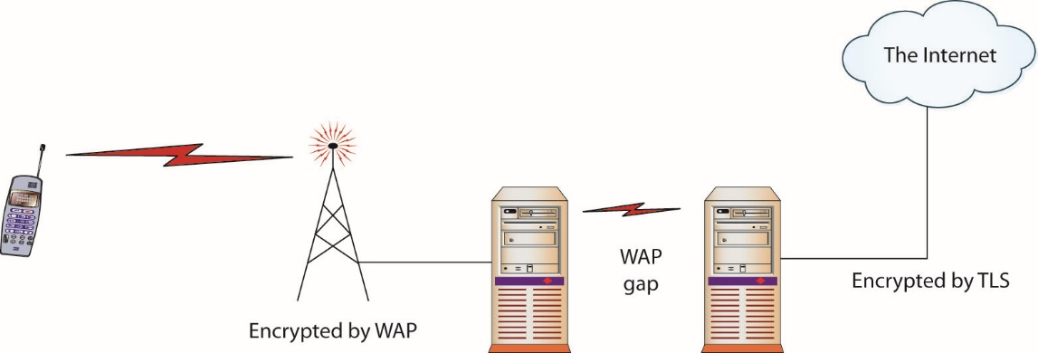
Figure 12.2 The WAP gap shows an unencrypted space between two enciphered connections.
Notes:
Some concern over the so-called WAP gap involves confidentiality of information where the two different networks meet, the WAP gateway, as shown in this figure.

Slide 114
3G Mobile Networks
Several competing data transmission standards, such as HSPA and EVDO, exist for 3G networks.
All standards include transport layer encryption protocols to secure the voice traffic traveling across the wireless signal as well as the data sent by the device.
KASUMI is the proposed 3G cryptographic standard.
This modified version of the MISTY1 algorithm uses 64-bit blocks and 128-bit keys.
Multiple attacks have been launched against this cipher.
Notes:
Our cell phones are one of the most visible indicators of advancing technology. Within recent memory, we were forced to switch from old analog phones to digital models. The networks have been upgraded to 3G, greatly enhancing speed and lowering latency. This has reduced the need for lightweight protocols to handle data transmission, and more standard protocols such as IP can be used. The increased power and memory of the handheld devices also reduce the need for lighter-weight encryption protocols. This has caused the protocols used for 3G mobile devices to build in their own encryption protocols. Security will rely on these lower-level protocols or standard application-level security protocols used in normal IP traffic.
Multiple attacks have been launched against this cipher. While the attacks tend to be impractical, this shows that application layer security is needed for secure transmission of data on mobile devices. WAP and WTLS can be used over the lower-level protocols, but traditional TLS can also be used.

Slide 115
4G Mobile Networks
4G can support high-quality VoIP connections, video calls, and real-time video streaming.
True 4G would require a firm to meet all of the technical standards issued by the ITU, including specifications that apply to the tower side of the system.
Most 4G deployments are continuations of technologies already deployed—just newer evolutions of standards.
Notes:
Just as the mobile network carriers were finishing the rollout of 3G services, 4G networks appeared on the horizon. The desire for anywhere, anytime Internet connectivity at speeds near that of a wired connection drives deployment of these next-generation services. 4G can support high-quality VoIP connections, video calls, and real-time video streaming. Just as 3G had some intermediaries that were considered 2.9G, LTE and WiMAX networks are sometimes referred to as 3.5G, 3.75G, or 3.9G. The carriers are marketing these new networks as 4G, although they do not adhere to the ITU standards for 4G speeds.
Some of the 4G requirements are:
Be based on an all-IP packet switched network
Offer high quality of service for next-generation multimedia support
Smooth handovers across heterogeneous networks
Peak data rates of up to approximately 100 Mbps for high mobility (mobile access)
Peak data rates of up to approximately 1 Gbps for low mobility such as nomadic/local wireless access
Dynamically share and use the network resources to support more simultaneous users per cell
Use scalable channel bandwidths of 5–20 MHz, optionally up to 40 MHz
Peak link spectral efficiency of 15-bps/Hz in the downlink, and 6.75-bps/Hz in the uplink
To achieve these and other technical elements requires specific tower-side equipment as well as handset specifications. Different carriers have chosen different sets of these to include in their offerings, each building upon their existing networks and existing technologies.
Most 4G deployments are continuations of technologies already deployed—just newer evolutions of standards. This is how LTE, LTE Advanced, WiMAX, and WiMAX 2 were born. LTE and WiMAX series come from separate roots, and are not interchangeable. Within the families, interoperability is possible and is dependent upon carrier implementation.

Slide 116
Bluetooth
Bluetooth is a short-range (approx. 32 feet), low-power wireless protocol transmitting in the 2.4 GHz band.
Bluetooth transmits data in Personal Area Networks (PANs) through mobile phones, laptops, printers, and audio devices.
Version 1.2 allows speeds up to 721 Kbps and improves resistance to interference over version 1.1.
Bluetooth 2.0 introduced enhanced data rate (EDR), which allows the transmission of up to 3.0 Mbps.
Notes:
Bluetooth was originally developed by Ericsson and known as multi-communicator link; in 1998, Nokia, IBM, Intel, and Toshiba joined Ericsson and adopted the Bluetooth name. This consortium became known as the Bluetooth Special Interest Group (SIG). The SIG now has more than 24,000 members and drives the development of the technology and controls the specification to ensure interoperability.
Most people are familiar with Bluetooth as it is part of many mobile phones and headsets, such as those shown in Figure 12.3. This short-range, low-power wireless protocol transmits in the 2.4 GHz band, the same band used for 802.11. The concept for the short-range (approx. 32 feet) wireless protocol is to transmit data in personal area networks (PANs).
Bluetooth transmits and receives data from a variety of devices, the most common being mobile phones, laptops, printers, and audio devices. The mobile phone has driven a lot of Bluetooth growth and has even spread Bluetooth into new cars as a mobile phone hands-free kit.
Bluetooth has gone through a few releases. Version 1.1 was the first commercially successful version, with version 1.2 released in 2007 and correcting some of the problems found in 1.1. Version 1.2 allows speeds up to 721 Kbps and improves resistance to interference. Version 1.2 is backward-compatible with version 1.1. With the rate of advancement and the life of most tech items, Bluetooth 1 series is basically extinct. Bluetooth 2.0 introduced enhanced data rate (EDR), which allows the transmission of up to 3.0 Mbps. Bluetooth 3.0 has the capability to use an 802.11 channel to achieve speeds up to 24 Mbps. The current version is the Bluetooth 4.0 standard with support for three modes: classic, high speed, and low energy.
Bluetooth 4 introduces a new method to support collecting data from devices that generate data at a very low rate. Some devices, such as medical devices, may only collect and transmit data at low rates. This feature, called Low Energy (LE), was designed to aggregate data from various sensors, like heart rate monitors, thermometers, and so forth, and carries the commercial name Bluetooth Smart.
As Bluetooth became popular, people started trying to find holes in it.
Bluetooth features easy configuration of devices to allow communication, with no need for network addresses or ports. Bluetooth uses pairing to establish a trust relationship between devices. To establish that trust, the devices advertise capabilities and require a passkey. To help maintain security, most devices require the passkey to be entered into both devices; this prevents a default passkey–type attack. The Bluetooth’s protocol advertisement of services and pairing properties is where some of the security issues start.

Slide 117
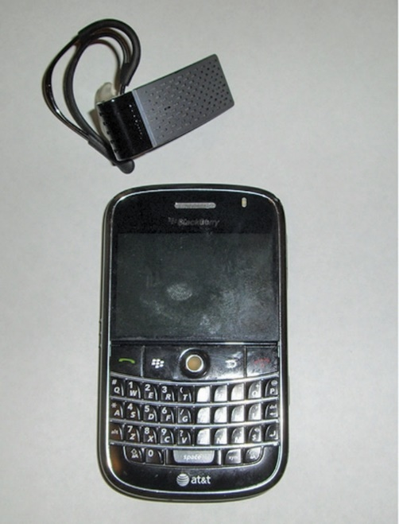
Figure 12.3 Headsets and cell phones are two of the most popular types of Bluetooth-capable devices.
Notes:
Most people are familiar with Bluetooth as it is part of many mobile phones and headsets, such as those shown in this figure.

Slide 118
Bluetooth (continued)
Bluetooth 4 introduces a new method to support collecting data from devices that generate data at a very low rate.
Bluetooth features easy configuration of devices to allow communication, with no need for network addresses or ports.
Bluetooth uses pairing to establish a trust relationship between devices.
Notes:
Bluetooth was originally developed by Ericsson and known as multi-communicator link; in 1998, Nokia, IBM, Intel, and Toshiba joined Ericsson and adopted the Bluetooth name. This consortium became known as the Bluetooth Special Interest Group (SIG). The SIG now has more than 24,000 members and drives the development of the technology and controls the specification to ensure interoperability.
Most people are familiar with Bluetooth as it is part of many mobile phones and headsets, such as those shown in Figure 12.3. This short-range, low-power wireless protocol transmits in the 2.4 GHz band, the same band used for 802.11. The concept for the short-range (approx. 32 feet) wireless protocol is to transmit data in personal area networks (PANs).
Bluetooth transmits and receives data from a variety of devices, the most common being mobile phones, laptops, printers, and audio devices. The mobile phone has driven a lot of Bluetooth growth and has even spread Bluetooth into new cars as a mobile phone hands-free kit.
Bluetooth has gone through a few releases. Version 1.1 was the first commercially successful version, with version 1.2 released in 2007 and correcting some of the problems found in 1.1. Version 1.2 allows speeds up to 721 Kbps and improves resistance to interference. Version 1.2 is backward-compatible with version 1.1. With the rate of advancement and the life of most tech items, Bluetooth 1 series is basically extinct. Bluetooth 2.0 introduced enhanced data rate (EDR), which allows the transmission of up to 3.0 Mbps. Bluetooth 3.0 has the capability to use an 802.11 channel to achieve speeds up to 24 Mbps. The current version is the Bluetooth 4.0 standard with support for three modes: classic, high speed, and low energy.
Bluetooth 4 introduces a new method to support collecting data from devices that generate data at a very low rate. Some devices, such as medical devices, may only collect and transmit data at low rates. This feature, called Low Energy (LE), was designed to aggregate data from various sensors, like heart rate monitors, thermometers, and so forth, and carries the commercial name Bluetooth Smart.
As Bluetooth became popular, people started trying to find holes in it.
Bluetooth features easy configuration of devices to allow communication, with no need for network addresses or ports. Bluetooth uses pairing to establish a trust relationship between devices. To establish that trust, the devices advertise capabilities and require a passkey. To help maintain security, most devices require the passkey to be entered into both devices; this prevents a default passkey–type attack. The Bluetooth’s protocol advertisement of services and pairing properties is where some of the security issues start.

Slide 119
Bluetooth Attacks
Bluejacking – the sending of unauthorized messages to another Bluetooth device.
Bluesnarfing – the attacker copies off the victim’s information
Can include e-mails, contact lists, calendar, etc.
Bluebugging – the attacker uses Bluetooth to establish a serial connection to the device.
Bluetooth DOS – using Bluetooth technology to perform a denial-of-service attack against another device.
Notes:
Bluejacking involves setting a message as a phonebook contact. Then the attacker sends the message to the possible recipient via Bluetooth. Originally, this involved sending text messages, but more recent phones can send images or audio as well. A popular variant of this is the transmission of “shock” images, featuring disturbing or crude photos. As Bluetooth is a short-range protocol, the attack and victim must be within roughly 10 yards of each other. The victim’s phone must also have Bluetooth enabled and must be in discoverable mode. On some early phones, this was the default configuration, and while it makes connecting external devices easier, it also allows attacks against the phone. If Bluetooth is turned off, or if the device is set to non-discoverable, bluejacking can be avoided.
Bluesnarfing is similar to bluejacking in that it uses the same contact transmission protocol. The difference is that instead of sending an unsolicited message to the victim’s phone, the attacker copies off the victim’s information, which can include e-mails, contact lists, calendar, and anything else that exists on that device. More recent phones with media capabilities can be snarfed for private photos and videos. Bluesnarfing used to require a laptop with a Bluetooth adapter, making it relatively easy to identify a possible attacker, but bluesnarfing applications are now available for mobile devices. Bloover, a combination of Bluetooth and Hoover, is one such application that runs as a Java applet. The majority of Bluetooth phones need to be discoverable for the bluesnarf attack to work, but it does not necessarily need to be paired. In theory, an attacker can also brute-force the device’s unique 48-bit name. A program called RedFang attempts to perform this brute-force attack by sending all possible names and seeing what gets a response. This approach was addressed in Bluetooth 1.2 with an anonymity mode.
Bluebugging is a far more serious attack than either bluejacking or bluesnarfing. In bluebugging, the attacker uses Bluetooth to establish a serial connection to the device. This allows access to the full AT command set—GSM phones use AT commands similar to Hayes-compatible modems. This connection allows full control over the phone, including the placing of calls to any number without the phone owner’s knowledge. Fortunately, this attack requires pairing of the devices to complete, and phones initially vulnerable to the attack have updated firmware to correct the problem. To accomplish the attack now, the phone owner would need to surrender her phone and allow an attacker to physically establish the connection.
Bluetooth DOS is the use of Bluetooth technology to perform a denial-of-service attack against another device. In this attack, an attacker repeatedly requests pairing with the victim device. This type of attack does not divulge information or permit access, but is a nuisance. And, more importantly, if done repeatedly it can drain a device’s battery, or prevent other operations from occurring on the victim’s device. As with all Bluetooth attacks, because of the short range involved, all one has to do is leave the area and the attack would cease.

Slide 120
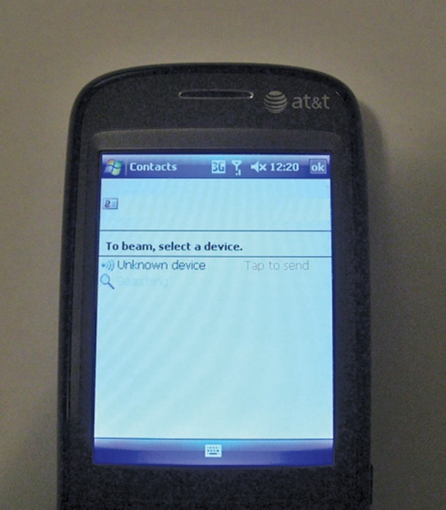
Bluejacking involves setting a message as a phonebook contact .

Slide 121
Near Field Communication
Near field communication (NFC) is a set of wireless technologies.
NFC enables smartphones and other devices to establish radio communication over a short proximity, typically a distance of 10 cm (3.9 in) or less.
This technology did not see much use until recently when it started being employed to move data between cell phones and in mobile payment systems.
NFC is likely to become a high use technology in the years to come.
Notes:
NFC is likely to become a high use technology in the years to come as multiple uses exist for the technology, and the next generation of smartphones is surely to see this as a standard function.

Slide 122
IEEE 802.11 Series
802.11 was a new standard for sending packetized data traffic over radio waves in the unlicensed 2.4 GHz band.
This group of IEEE standards is also called Wi-Fi.
The 802.11b standard was the first to market, 802.11a followed, and 802.11g products currently are the most common ones being sold.
Chipsets have been combined into devices that support a/b/g standards with 802.11n as the latest standard.
802.11a is the wireless networking standard that supports traffic on the 5 GHz band.
Notes:
Features of 802.11b and 802.11a were later joined to create 802.11g, an updated standard that allows the faster speeds of the 5 GHz specification on the 2.4 GHz band. Security problems were discovered in the implementations of these early wireless standards, principally involving the Wired Equivalent Privacy (WEP) protocol. These problems included an attacker’s ability to break the cryptography and monitor other users’ traffic. The security problems in WEP were a top concern until the adoption of 802.11i-compliant products enhanced the security with Wi-Fi Protected Access (WPA), discussed later in the chapter. 802.11ac is the latest standard; it focuses on achieving much higher speeds for wireless networks.

Slide 123
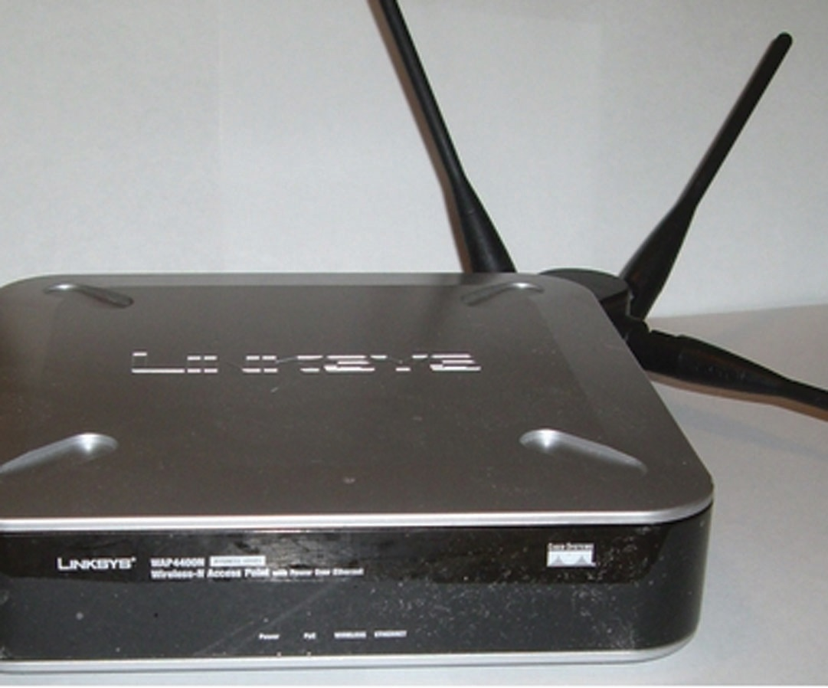
Figure 12.4 A common wireless router
Notes:
The 802.11b protocol is an IEEE standard ratified in 1999. The standard launched a range of products (such as wireless routers, an example of which is shown in this figure) that would open the way to a whole new genre of possibilities for attackers and a new series of headaches for security administrators everywhere.

Slide 124
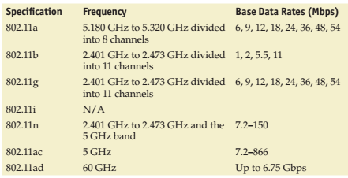
Notes:
IEEE 802.11 standards

Slide 125
IEEE 802.11 Series (continued)
Direct-sequence spread spectrum (DSSS)
A modulation type that spreads the traffic sent over the entire bandwidth.
Orthogonal frequency division multiplexing (OFDM)
OFDM multiplexes, or separates, the data to be transmitted into smaller chunks and then transmits the chunks on several subchannels.
Orthogonal refers to the manner in which the subchannels are assigned, principally to avoid crosstalk, or interference with your own channels.
Notes:
Direct-sequence spread spectrum (DSSS) is a modulation type that spreads the traffic sent over the entire bandwidth. It does this by injecting a noise-like signal into the information stream and transmitting the normally narrowband information over the wider band available. The primary reason that spread-spectrum technology is used in 802.11 protocols is to avoid interference on the public 2.4 GHz and 5 GHz bands.
Orthogonal frequency division multiplexing (OFDM) multiplexes, or separates, the data to be transmitted into smaller chunks and then transmits the chunks on several subchannels. This use of subchannels is what the “frequency division” portion of the name refers to. Both of these techniques, multiplexing and frequency division, are used to avoid interference.

Slide 126
802.11: Individual Standards
The 802.11b protocol provides for multiple-rate Ethernet over 2.4 GHz spread-spectrum wireless.
It provides transfer rates of 1 Mbps, 2 Mbps, 5.5 Mbps, and 11 Mbps and uses DSSS.
Most common layout is a point-to-multipoint environment.
802.11a uses a higher band and has higher bandwidth.
It operates in the 5 GHz spectrum using OFDM and supports rates of up to 54 Mbps.
The higher frequency shortens the usable range.
Notes:
The 802.11b protocol provides for multiple-rate Ethernet over 2.4 GHz spread-spectrum wireless. It provides transfer rates of 1 Mbps, 2 Mbps, 5.5 Mbps, and 11 Mbps and uses DSSS. The most common layout is a point-to-multipoint environment, with the available bandwidth being shared by all users. Typical range is roughly 100 yards indoors and 300 yards outdoors, line of sight. While the wireless transmissions of 802.11 can penetrate some walls and other objects, the best range is offered when both the access point and network client devices have an unobstructed view of each other.
802.11a uses a higher band and has higher bandwidth. It operates in the 5 GHz spectrum using OFDM. Supporting rates of up to 54 Mbps, it is the faster brother of 802.11b; however, the higher frequency used by 802.11a shortens the usable range of the devices and makes it incompatible with 802.11b. The chipsets tend to be more expensive for 802.11a, which has slowed adoption of the standard.

Slide 127
802.11: Individual Standards (continued)
The 802.11g standard uses portions of both of the other standards.
It uses the 2.4 GHz band for greater range but uses the OFDM transmission method to achieve the faster 54 Mbps data rates.
The 802.11n version improves on the older standards by greatly increasing speed.
It has a functional data rate of up to 600 Mbps, gained through the use of wider bands and multiple-input multiple-output (MIMO) processing.
Notes:
The 802.11g standard uses portions of both of the other standards: it uses the 2.4 GHz band for greater range but uses the OFDM transmission method to achieve the faster 54 Mbps data rates. As it uses the 2.4 GHz band, this standard interoperates with the older 802.11b standard. This allows an 802.11g access point (AP) to give access to both “G” and “B” clients.
The 802.11n version improves on the older standards by greatly increasing speed. It has a functional data rate of up to 600 Mbps, gained through the use of wider bands and multiple-input multiple-output (MIMO) processing. MIMO uses multiple antennas and can bond separate channels together to increase data throughput.
802.11ac is the latest in the 5 GHz band, with functional data rates up to a theoretical 6+ Gbps using multiple antennas. The 802.11ac standard was ratified in 2014, and chipsets have been available since late 2011. Designed for multimedia streaming and other high-bandwidth operations, the individual channels are twice the width of 802.11n channels, and as many as eight antennas can be deployed in a Mu-MIMO form.

Slide 128
802.11: Individual Standards (continued)
802.11ac is the latest in the 5 GHz band, with functional data rates up to a theoretical 6+ Gbps using multiple antennas.
Standard was ratified in 2014.
Chipsets have been available since late 2011.
All these protocols operate in bands that are “unlicensed” by the FCC.
The 802.11 standard includes attempts at rudimentary authentication and confidentiality controls.
Notes:
802.11ac is the latest in the 5 GHz band, with functional data rates up to a theoretical 6+ Gbps using multiple antennas. The 802.11ac standard was ratified in 2014, and chipsets have been available since late 2011. Designed for multimedia streaming and other high-bandwidth operations, the individual channels are twice the width of 802.11n channels, and as many as eight antennas can be deployed in a Mu-MIMO form.
All these protocols operate in bands that are “unlicensed” by the FCC. This means that people operating this equipment do not have to be certified by the FCC, but it also means that the devices could possibly share the band with other devices, such as cordless phones, closed-circuit TV (CCTV) wireless transceivers, and other similar equipment. This other equipment can cause interference with the 802.11 equipment, possibly causing speed degradation.
The 802.11 protocol designers expected some security concerns and attempted to build provisions into the 802.11 protocol that would ensure adequate security. The 802.11 standard includes attempts at rudimentary authentication and confidentiality controls. Authentication is handled in its most basic form by the 802.11 AP, forcing the clients to perform a handshake when attempting to “associate” to the AP.

Slide 129
802.11: Individual Standards (continued)
Association is the process required before the AP will allow the client to talk across the AP to the network.
Association occurs only if the client has all the correct parameters needed in the handshake, among them the service set identifier (SSID).
The SSID is a phrase-based mechanism that helps ensure that you are connecting to the correct AP.
This SSID phrase is transmitted in all the access point’s beacon frames.
It is an 802.11 management frame for the network.
Notes:
Association is the process required before the AP will allow the client to talk across the AP to the network. Association occurs only if the client has all the correct parameters needed in the handshake, among them the service set identifier (SSID). This SSID setting should limit access only to the authorized users of the wireless network. The SSID is a phrase-based mechanism that helps ensure that you are connecting to the correct AP. This SSID phrase is transmitted in all the access point’s beacon frames. The beacon frame is an 802.11 management frame for the network and contains several different fields, such as the timestamp and beacon interval, but most importantly the SSID. This allows attackers to scan for the beacon frame and retrieve the SSID.
The designers of the 802.11 standard also attempted to maintain confidentiality by introducing Wired Equivalent Privacy (WEP), which uses the RC4 stream cipher to encrypt the data as it is transmitted through the air. WEP has been shown to have an implementation problem that can be exploited to break security.

Slide 130
802.11: Individual Standards (continued)
The designers of the 802.11 standard attempted to maintain confidentiality by introducing Wired Equivalent Privacy (WEP), which uses the RC4 stream cipher to encrypt the data as it is transmitted through the air.
WEP can be exploited to break security.
Typically, access to actual Ethernet segments is protected by physical security measures.
A typical wireless installation broadcasts the network right through the physical controls that are in place.
Notes:
The designers of the 802.11 standard also attempted to maintain confidentiality by introducing Wired Equivalent Privacy (WEP), which uses the RC4 stream cipher to encrypt the data as it is transmitted through the air. WEP has been shown to have an implementation problem that can be exploited to break security.
Typically, access to actual Ethernet segments is protected by physical security measures. This structure allows security administrators to plan for only internal threats to the network and gives them a clear idea of the types and number of machines connected to it. Wireless networking takes the keys to the kingdom and tosses them out the window and into the parking lot. A typical wireless installation broadcasts the network right through the physical controls that are in place. An attacker can drive up and have the same access as if he plugged into an Ethernet jack inside the building—in fact, better access, because 802.11 is a shared medium, allowing sniffers to view all packets being sent to or from the AP and all clients. These APs are also typically behind any security measures the companies have in place, such as firewalls and intrusion detection systems (IDSs). This kind of access into the internal network has caused a large stir among computer security professionals and eventually the media. War-driving, war-flying, warwalking, war-chalking—all of these terms have been used in security article after security article to describe attacks on wireless networks.

Slide 131
Module 7 Infrastructure security and wireless security Part 4

Slide 132
Attacking 802.11
Wireless is a popular target for several reasons:
Access gained from wireless
Lack of default security
Wide proliferation of devices
Anonymity
Low cost of the equipment needed
Notes:
Wireless is a popular target for several reasons: the access gained from wireless, the lack of default security, and the wide proliferation of devices.
However, other reasons also make it attackable. The first of these is anonymity: An attacker can probe your building for wireless access from the street. Then he can log packets to and from the AP without giving any indication that an attempted intrusion is taking place. The attacker will announce his presence only if he attempts to associate to the AP. Even then, an attempted association is recorded only by the MAC address of the wireless card associating to it, and most APs do not have alerting functionality to indicate when users associate to it. This fact gives administrators a very limited view of who is gaining access to the network, if they are even paying attention at all. It gives attackers the ability to seek out and compromise wireless networks with relative impunity.
The second reason is the low cost of the equipment needed. A single wireless access card costing less than $100 can give access to any unsecured AP within driving range. Finally, attacking a wireless network is relatively easy compared to attacking other target hosts. Windows-based tools for locating and sniffing wireless-based networks have turned anyone who can download files from the Internet and has a wireless card into a potential attacker.

Slide 133
Attacking 802.11 (continued)
Locating wireless networks was originally termed war-driving an adaptation of the term war-dialing.
War-dialing is the process of dialing a list of phone numbers looking for modem-connected computers.
War-drivers drive around with a wireless locater program recording the number of networks found and their locations.
War-chalking started with people using chalk on sidewalks to mark some of the wireless networks they found.
Notes:
Locating wireless networks was originally termed war-driving, an adaptation of the term war-dialing. War-dialing comes from the 1983 movie WarGames; it is the process of dialing a list of phone numbers looking for modem-connected computers. War-drivers drive around with a wireless locater program recording the number of networks found and their locations. This term has evolved along with war-flying and war-walking, which mean exactly what you expect. War-chalking started with people using chalk on sidewalks to mark some of the wireless networks they found.

Slide 134
Attacking 802.11 (continued)
NetStumbler, a reception-based program, listens for the beacon frames of APs that are within range of the card attached to the NetStumbler computer.
A network sniffer is used once an attacker has located a network if he cannot directly connect and start active scanning and penetration of the network.
There are specialized sniffer tools designed with a single objective:
To crack Wired Equivalent Privacy (WEP) keys
Notes:
Once an attacker has located a network, and assuming that he cannot directly connect and start active scanning and penetration of the network, he will use the best attack tool there is: a network sniffer. The network sniffer, when combined with a wireless network card it can support, is a powerful attack tool, as the shared medium of a wireless network exposes all packets to interception and logging. Popular wireless sniffers are Wireshark (formerly Ethereal) and Kismet. Regular sniffers used on wired Ethernet have also been updated to include support for wireless. Sniffers are also important because they allow you to retrieve the MAC addresses of the nodes of the network. APs can be configured to allow access only to pre-specified MAC addresses, and an attacker spoofing the MAC can bypass this feature. GPS unit attached to it, the program also logs the AP’s coordinates. This information can be used to return to the AP or to plot maps of APs in a city.
There are specialized sniffer tools designed with a single objective: to crack Wired Equivalent Privacy (WEP) keys. As described earlier, WEP is an encryption protocol that 802.11 uses to attempt to ensure confidentiality of wireless communications. Unfortunately, it has turned out to have several problems. WEP’s weaknesses are specifically targeted for attack by the specialized sniffer programs. They work by exploiting weak initialization vectors in the encryption algorithm. To exploit this weakness, an attacker needs a certain number of ciphertext packets; once he has captured enough packets, however, the program can very quickly decipher the encryption key being used. WEPCrack was the first available program to use this flaw to crack WEP keys; however, WEPCrack depends on a dump of actual network packets from another sniffer program. AirSnort is a standalone program that captures its own packets; once it has captured enough ciphertext, it provides the WEP key of the network.

Slide 135
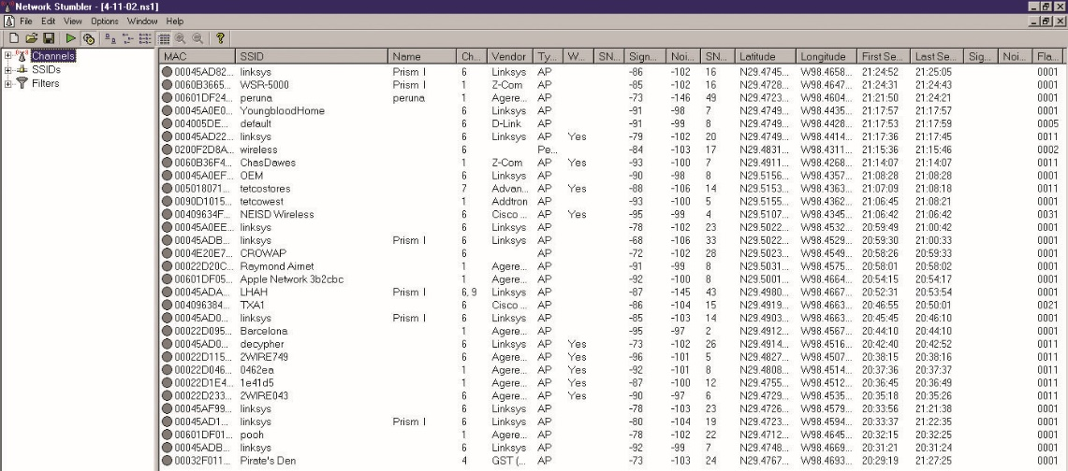
Figure 12.5 NetStumbler on a Windows PC
Notes:
The most common tools for an attacker to use are reception-based programs that listen to the beacon frames output by other wireless devices, and programs that promiscuously capture all traffic. The most widely used of these programs is called NetStumbler, created by Marius Milner and shown in this figure.

Slide 136
Attacking 802.11 (continued)
If unauthorized wireless is set up, it is known as a rogue access point.
Another type of 802.11 attack is known as the evil twin attack.
This is the use of an access point owned by an attacker that usually has been enhanced with higher-power and higher-gain antennas to look like a better connection to the users and computers attaching to it.
Notes:
Rogue access points can be set up by well-meaning employees or hidden by an attacker with physical access. An attacker might set up a rogue access point if they have a limited amount of physical access to an organization, perhaps by sneaking into the building briefly. The attacker can then set up an AP on the network and, by placing it behind the external firewall or network IDS (NIDS) type of security measures, can attach to the wireless at a later date at their leisure. This approach reduces the risk of getting caught by physical security staff, and if the AP is found, it does not point directly back to any kind of traceable address.
Another type of 802.11 attack is known as the evil twin attack. This is the use of an access point owned by an attacker that usually has been enhanced with higher-power and higher-gain antennas to look like a better connection to the users and computers attaching to it. By getting users to connect through the evil access point, attackers can more easily analyze traffic and perform man-in-the-middle−type attacks. For simple denial of service, an attacker could use interference to jam the wireless signal, not allowing any computer to connect to the access point successfully.

Slide 137
Attacking 802.11 (continued)
The service set identifier (SSID) is sent in plaintext in the packets, so in practice SSID offers little security significance—any sniffer can determine the SSID.
Most APs’ default setting is to transmit beacon frames and this is damaging because it contains the SSID.
Most APs have the ability to lock access in only to known MAC addresses.
Sniffers can grab all active MAC addresses on the network so this capability is not very effective.

Slide 138
Attacking 802.11 (continued)
The IV is the primary reason for the weaknesses in WEP.
The IV is sent in the plaintext part of the message.
The IV problem exists regardless of key length, because the IV always remains at 24 bits.
After the limited security functions of a wireless network are broken, the network behaves exactly like a regular Ethernet network and is subject to the exact same vulnerabilities.

Slide 139
Current Security Methods
The Wi-Fi Alliance developed Wi-Fi Protected Access (WPA) to improve upon WEP.
The 802.11i standard is the IEEE standard for security in wireless networks.
Also known as Wi-Fi Protected Access 2 (WPA2).
Uses 802.1X to provide authentication
Can use Advanced Encryption Standard (AES) as the encryption protocol
Uses the Temporal Key Integrity Protocol (TKIP)
Uses AES with the Counter Mode with CBC-MAC Protocol

Slide 140
Current Security Methods (continued)
TKIP works by using a shared secret combined with the card’s MAC address.
A new key is generated and mixed with the IV to make per-packet keys that encrypt a single packet using the same RC4 cipher used by traditional WEP.
CCMP is actually the mode in which the AES cipher is used to provide message integrity.
CCMP requires new hardware to perform the AES encryption.
802.11i corrects the weaknesses of WEP.

Slide 141
Current Security Methods (continued)
WPA uses the flawed WEP algorithm with the Temporal Key Integrity Protocol (TKIP).
TKIP employs a per-packet key, generating a new 128-bit key for each packet.
Temporal Key Integrity Protocol (TKIP) was created as a stopgap security measure to replace WEP.
Did not require the replacement of legacy hardware
Mixes a secret root key with the IV before RC4 encryption
Vulnerable to a number of similar WEP attacks
No longer considered secure

Slide 142
Current Security Methods (continued)
IEEE 802.11i is the standard for security in wireless networks and is also known as Wi-Fi Protected Access 2 (WPA2).
Uses 802.1x to provide authentication and uses the Advanced Encryption Standard (AES) for encryption
Uses the AES block cipher
Wi-Fi Protected Setup (WPS) provides an easy method of configuring wireless networks.
WPS uses an eight-digit PIN to configure wireless devices.
It is susceptible to a brute-force attack.

Slide 143
Current Security Methods (continued)
Steps in setting Up WPA2 are:
First choose a security framework
When configuring an adapter to connect to an existing network, you need to match the choice of the network.
For security purposes, you should choose WPA2-Personal or WPA2-Enterprise.
Choose AES encryption
Choose the network security key
Notes:
To set up WPA2, you need to have several parameters. The first element is to choose a security framework. When configuring an adapter to connect to an existing network, you need to match the choice of the network. When setting up your own network, you can choose whichever option you prefer. There are many selections, but for security purposes, you should choose WPA2-Personal or WPA2-Enterprise. Both of these require the choice of an encryption type, either TKIP or AES. TKIP has been deprecated, so choose AES. The last element is the choice of the network security key—the secret that is shared by all users. WPA2-Enterprise, which is designed to be used with an 802.1x authentication server that distributes different keys to each user, is typically used in business environments.

Slide 144
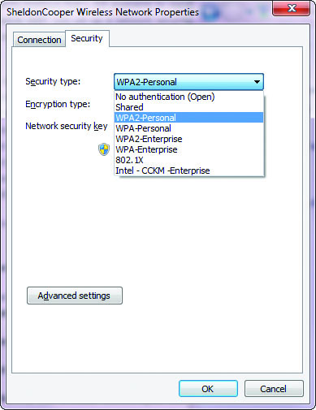
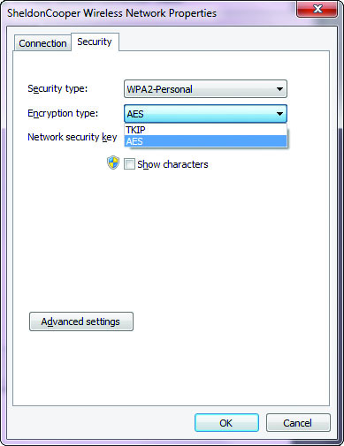
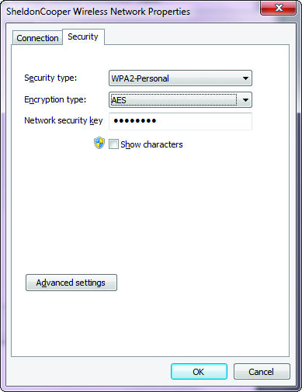
Figure 12.6 WPA2 setup options in Windows 7
Notes:
This figure shows the screens for a WPA2 setup in Windows 7.

Slide 145
Current Security Methods (continued)
Extensible Authentication Protocol (EAP) is defined in RFC 2284 (obsoleted by 3748).
EAP-TLS relies on Transport Layer Security (TLS).
EAP-TTLS works with the server authenticating to the client with a certificate, but the protocol tunnels the client side of the authentication, allowing the use of legacy authentication protocols such as Password Authentication Protocol (PAP), Challenge-Handshake Authentication Protocol (CHAP), MS-CHAP, or MS-CHAP-V2.

Slide 146
Current Security Methods (continued)
Lightweight Extensible Authentication Protocol (LEAP) is a proprietary EAP designed by Cisco.
Being phased out for newer protocols: PEAP or EAP-TLS
PEAP, or Protected EAP, is an open standard
Developed to protect the EAP communication by encapsulating it with TLS
Developed jointly by Cisco, Microsoft, and RSA
Designed assuming a secure communication channel
Widely supported by vendors for use over wireless networks

Slide 147
Implementing 802.1X
Implementing 802.1X
The IEEE 802.1X protocol can support a wide variety of authentication methods and also fits well into existing authentication systems such as RADIUS and LDAP.
This allows 802.1X to interoperate well with other systems such as VPNs and dial-up RAS.
Three common methods are used to implement 802.1X: EAP-TLS, EAPTTLS, and EAP-MD5.
Notes:
Three common methods are used to implement 802.1X: EAP-TLS, EAPTTLS, and EAP-MD5. EAP-TLS relies on TLS, an attempt to standardize the SSL structure to pass credentials. The standard, developed by Microsoft, uses X.509 certificates and offers dynamic WEP key generation. This means that the organization must have the ability to support the public key infrastructure (PKI) in the form of X.509 digital certificates. Also, per-user, per-session dynamically generated WEP keys help prevent anyone from cracking the WEP keys in use, as each user individually has her own WEP key. Even if a user were logged onto the AP and transmitted enough traffic to allow cracking of the WEP key, access would be gained only to that user’s traffic. No other user’s data would be compromised, and the attacker could not use the WEP key to connect to the AP. This standard authenticates the client to the AP, but it also authenticates the AP to the client, helping to avoid man-in-the-middle attacks. The main problem with the EAP-TLS protocol is that it is designed to work only with Microsoft’s Active Directory and Certificate Services; it will not take certificates from other certificate issuers. Thus a mixed environment would have implementation problems.
As discussed earlier, EAP-TTLS works much the same way as EAP-TLS, with the server authenticating to the client with a certificate, but the protocol tunnels the client side of the authentication, allowing the use of legacy authentication protocols such as Password Authentication Protocol (PAP), Challenge-Handshake Authentication Protocol (CHAP), MS-CHAP, or MSCHAP-V2. This makes the protocol more versatile while still supporting the enhanced security features such as dynamic WEP key assignment.
EAP-MD5, while it does improve the authentication of the client to the AP, does little else to improve the security of your AP. The protocol works by using the MD5 encryption protocol to hash a user’s username and password. This protocol, unfortunately, provides no way for the AP to authenticate with the client, and it does not provide for dynamic WEP key assignment. In the wireless environment, without strong two-way authentication, it is very easy for an attacker to perform a man-in-the-middle attack. Normally, these types of attacks are difficult to perform, requiring a traffic redirect of some kind, but wireless changes all those rules. By setting up a rogue AP, an attacker can attempt to get clients to connect to it as if it were authorized and then simply authenticate to the real AP, a simple way to have access to the network and the client’s credentials. The problem of not dynamically generating WEP keys is that it simply opens up the network to the same lack of confidentiality to which a normal AP is vulnerable. An attacker has to wait only for enough traffic to crack the WEP key, and he can then observe all traffic passing through the network.
Because the security of wireless LANs has been so problematic, many users have simply switched to a layered security approach—that is, they have moved their APs to untrustworthy portions of the network and have forced all clients to authenticate through the firewall to a third-party VPN system. The additional security comes at a price of putting more load on the firewall and VPN infrastructure and possibly adding cumbersome software to the users’ devices. While wireless can be set up in a very secure manner in this fashion, it can also be set up poorly. Some systems lack strong authentication of both endpoints, leading to possibilities of a man-in-the-middle attack. Also, even though the data is tunneled through, IP addresses are still sent in the clear, giving an attacker information about what and where your VPN endpoint is.
Another phenomenon of wireless is borne out of its wide availability and low price. All the security measures of the wired and wireless network can be defeated by the rogue AP. This is the third possible type of rogue access point discussed in this chapter; they all share the same name as they all represent a security breach. However, since they are implemented with different motives and accordingly pose slightly different threats, we discuss them all separately. In this case, a well-intentioned employee who is trying to make the work environment more convenient purchases an AP at a local retailer and installs it. When installed, it works fine, but it typically will have no security installed. Since the IT department doesn’t know about it, it is an uncontrolled entry point into the network.
No matter what kind of rogue AP we are dealing with, the rogue AP must be detected and controlled. The most common way to control rogue APs is some form of wireless scanning to ensure only legitimate wireless is in place at an organization. While complete wireless IDSs will detect APs, this can also be done with a laptop and free software.

Slide 148
Implementing 802.1X (continued)
EAP-TLS relies on TLS, an attempt to standardize the SSL structure to pass credentials.
EAP-TTLS works much the same way as EAP-TLS.
The server authenticates to the client with a certificate.
The protocol tunnels the client side of the authentication, allowing the use of legacy authentication protocols.
EAP-MD5 works by using the MD5 encryption protocol to hash a user’s username and password.
Notes:
Three common methods are used to implement 802.1X: EAP-TLS, EAPTTLS, and EAP-MD5. EAP-TLS relies on TLS, an attempt to standardize the SSL structure to pass credentials. The standard, developed by Microsoft, uses X.509 certificates and offers dynamic WEP key generation. This means that the organization must have the ability to support the public key infrastructure (PKI) in the form of X.509 digital certificates. Also, per-user, per-session dynamically generated WEP keys help prevent anyone from cracking the WEP keys in use, as each user individually has her own WEP key. Even if a user were logged onto the AP and transmitted enough traffic to allow cracking of the WEP key, access would be gained only to that user’s traffic. No other user’s data would be compromised, and the attacker could not use the WEP key to connect to the AP. This standard authenticates the client to the AP, but it also authenticates the AP to the client, helping to avoid man-in-the-middle attacks. The main problem with the EAP-TLS protocol is that it is designed to work only with Microsoft’s Active Directory and Certificate Services; it will not take certificates from other certificate issuers. Thus a mixed environment would have implementation problems.
As discussed earlier, EAP-TTLS works much the same way as EAP-TLS, with the server authenticating to the client with a certificate, but the protocol tunnels the client side of the authentication, allowing the use of legacy authentication protocols such as Password Authentication Protocol (PAP), Challenge-Handshake Authentication Protocol (CHAP), MS-CHAP, or MSCHAP-V2. This makes the protocol more versatile while still supporting the enhanced security features such as dynamic WEP key assignment.
EAP-MD5, while it does improve the authentication of the client to the AP, does little else to improve the security of your AP. The protocol works by using the MD5 encryption protocol to hash a user’s username and password. This protocol, unfortunately, provides no way for the AP to authenticate with the client, and it does not provide for dynamic WEP key assignment. In the wireless environment, without strong two-way authentication, it is very easy for an attacker to perform a man-in-the-middle attack. Normally, these types of attacks are difficult to perform, requiring a traffic redirect of some kind, but wireless changes all those rules. By setting up a rogue AP, an attacker can attempt to get clients to connect to it as if it were authorized and then simply authenticate to the real AP, a simple way to have access to the network and the client’s credentials. The problem of not dynamically generating WEP keys is that it simply opens up the network to the same lack of confidentiality to which a normal AP is vulnerable. An attacker has to wait only for enough traffic to crack the WEP key, and he can then observe all traffic passing through the network.

Slide 149
Current Security Methods
Because the security of wireless LANs has been so problematic, many users have simply switched to a layered security approach.
All the security measures of the wired and wireless network can be defeated by the rogue AP.
No matter what kind of rogue AP we are dealing with, the rogue AP must be detected and controlled.
Use some form of wireless scanning to ensure only legitimate wireless is in place at an organization.
Notes:
Because the security of wireless LANs has been so problematic, many users have simply switched to a layered security approach—that is, they have moved their APs to untrustworthy portions of the network and have forced all clients to authenticate through the firewall to a third-party VPN system. The additional security comes at a price of putting more load on the firewall and VPN infrastructure and possibly adding cumbersome software to the users’ devices. While wireless can be set up in a very secure manner in this fashion, it can also be set up poorly. Some systems lack strong authentication of both endpoints, leading to possibilities of a man-in-the-middle attack. Also, even though the data is tunneled through, IP addresses are still sent in the clear, giving an attacker information about what and where your VPN endpoint is.
Another phenomenon of wireless is borne out of its wide availability and low price. All the security measures of the wired and wireless network can be defeated by the rogue AP. This is the third possible type of rogue access point discussed in this chapter; they all share the same name as they all represent a security breach. However, since they are implemented with different motives and accordingly pose slightly different threats, we discuss them all separately. In this case, a well-intentioned employee who is trying to make the work environment more convenient purchases an AP at a local retailer and installs it. When installed, it works fine, but it typically will have no security installed. Since the IT department doesn’t know about it, it is an uncontrolled entry point into the network.
No matter what kind of rogue AP we are dealing with, the rogue AP must be detected and controlled. The most common way to control rogue APs is some form of wireless scanning to ensure only legitimate wireless is in place at an organization. While complete wireless IDSs will detect APs, this can also be done with a laptop and free software.

Slide 150
Current Security Methods (continued)
CCMP
Stands for Counter Mode with Cipher Block Chaining–Message Authentication Codes Protocol (or Counter Mode with CBC-MAC Protocol)
CCMP is a data encapsulation encryption mechanism designed for wireless use.
CCMP is the mode in which the AES cipher is used to provide message integrity.
CCMP requires new hardware to perform the AES encryption.

Slide 151
Current Security Methods (continued)
MAC filtering is the selective admission of packets based on a list of approved Media Access Control (MAC) addresses.
Employed on switches – provides machine authentication
Wired networks – has the protection afforded by the wires, making interception of signals to determine their MAC addresses difficult
Wireless networks – suffers from the fact that an attacker can see the MAC addresses of all traffic to and from the access point, and then can spoof the MAC addresses that are permitted to communicate via the access point

Slide 152
Wireless Systems Configuration
Wireless systems are more than just protocols.
Putting up a functional wireless system in a house is as easy as plugging in a wireless access point and connecting.
But in an enterprise, where multiple access points will be needed, the configuration takes significantly more work.
Site surveys are needed to determine proper access point and antenna placement, as well as channels and power levels.

Slide 153
Antenna Types
Omnidirectional antenna operates in all directions.
Covers the greatest area per antenna
Weakness occurs in corners and hard-to-reach areas
Yagi and panel antennas are directional in nature.
Panel antennas provide solid room performance while preventing signal bleed behind the antennas
Yagi antennas funnel the energy along a beam and allow longer communication distances using standard power
Enables eavesdroppers to capture signals from much greater distances
Notes:
Wireless networking problems caused by weak signal strength can sometimes be solved by installing upgraded Wi-Fi radio antennas on the access points. On business networks, the complexity of multiple access points typically requires a comprehensive site survey to map the Wi-Fi signal strength in and around office buildings. Additional wireless access points can then be strategically placed where needed to resolve dead spots in coverage. For small businesses and homes, where a single access point may be all that is needed, an antenna upgrade may be a simpler and more cost-effective option to fix Wi-Fi signal problems.

Slide 154
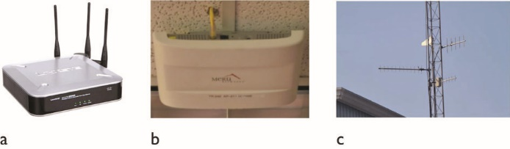
Figure 12.7 Wireless access point antennas
Notes:
This figure shows a sampling of common Wi-Fi antennas: (a) is a common home wireless router, (b) is a commercial indoor wireless access point, and (c) is an outdoor directional antenna. These can be visible as shown, or hidden above ceiling tiles.
Two common forms of upgraded antennas are the Yagi antenna and the panel antenna. An example of a Yagi antenna is shown in this figure (c).

Slide 155
Antenna Placement
The objective of antenna placement is to maximize the coverage over a physical area and reduce low-gain areas.
Can be very complex and frequently requires a site survey to determine proper placement
MIMO is a set of multiple-input and multiple-output antenna technologies where the available antennas are spread over a multitude of independent access points each having one or multiple antennas.
Notes:
Wi-Fi is by nature a radio-based method of communication, and as such uses antennas to transmit and receive the signals. The actual design and placement of the antennas can have a significant effect on the usability of the radio frequency (RF) medium for carrying the traffic. Antennas come in a variety of types, each with its own transmission pattern and gain factor. High-gain antennas can deal with weaker signals, but also have more-limited coverage. Wide-coverage, omnidirectional antennas can cover wider areas, but at lower levels of gain.
Mimo can enhance the usable bandwidth and data transmission capacity between the access point and user. There are a wide variety of MIMO methods, and this technology, once considered cutting edge or advanced, is becoming mainstream.

Slide 156
Power Level Controls
Wi-Fi power levels can be controlled by the hardware for a variety of reasons.
With lower power, there is less opportunity for interference.
If power levels are too low, signal strength limits range.
Access points can have the power level set either manually or via programmatic control.
For most users, default mode is the best option.
In complex setups, power level controls can increase capacity and control on the network.
Notes:
Access points can have the power level set either manually or via programmatic control. For most users, power level controls are not very useful, and leaving the unit in default mode is the best option. In complex enterprise setups, with site surveys and planned overlapping zones, this aspect of signal control can be used to increase capacity and control on the network.

Slide 157
Site Surveys
A site survey involves several steps:
Mapping the floor plan, testing for RF interference, testing for RF coverage, and analysis of material via software
The software can suggest placement of access points.
After deploying the APs, the site is surveyed again, mapping the results versus the predicted, watching signal strength and signal-to-noise ratios.
Site surveys can be used to ensure availability of wireless, especially when it is critical for users to have connections.
Notes:
Exam Tip: Wireless networks are dependent upon radio signals to function. It is important to understand that antenna type, placement, and site surveys are used to ensure proper coverage of a site, including areas blocked by walls, interfering signals, and echoes.

Slide 158
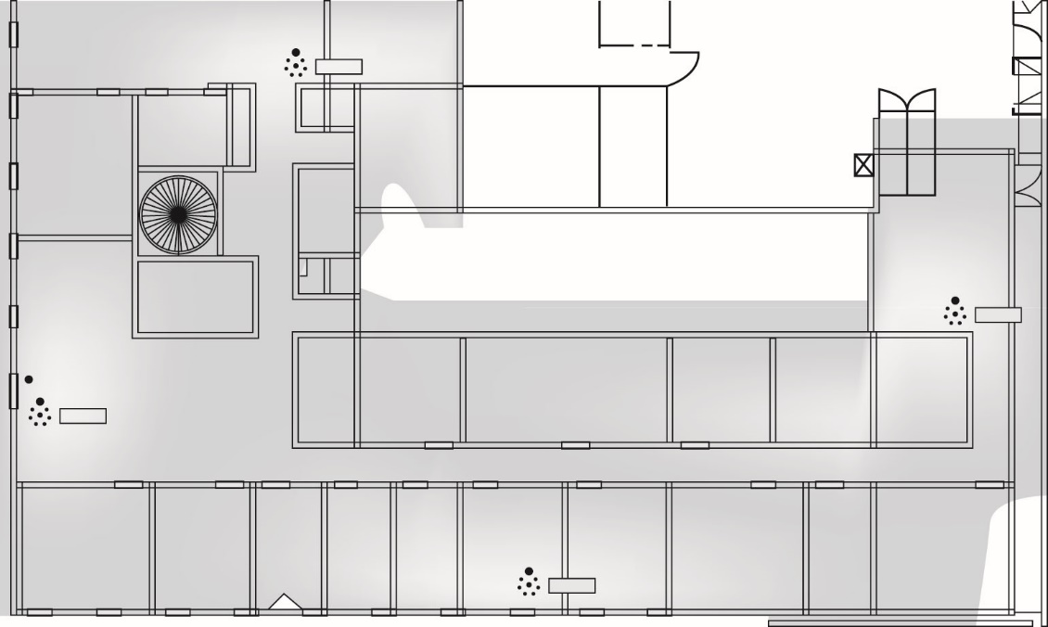
Figure 12.8 Exemple site survey
Notes:
This figure illustrates what a site survey looks like. The different shades indicate signal strength, showing where reception is strong and where it is weak.

Slide 159
Captive Portals
Captive portal refers to a specific technique of using an HTTP client to handle authentication on a wireless network.
It is frequently employed in public hotspots and opens a web browser to an authentication page.
This occurs before the user is granted admission to the network.
The access point intercepts all packets and returns the web page for login.
The actual web server that serves up the authentication page can be in a walled-off section of the network.

Slide 160
Securing Public Wi-Fi
Issue associated with wireless transmissions is that they are subject to interception by anyone within range of the hotspot.
Possible for others to intercept and read traffic of anyone using the hotspot, unless encryption is used.
Common practice is to use wireless security, even when the intent is to open the channel for everyone.
Having a default password, even one that everyone knows, will make it so that people cannot observe other traffic.
Notes:
There is an entire open wireless movement, designed around a sharing concept that promotes sharing of the Internet to all. For information, check out https://openwireless.org.

Slide 161
Mobile Devices
Mobile security is one of the fastest-changing areas of computer security due to fast-changing technology.
Data must be protected.
Mobile devices are capable of carrying and delivering viruses, worms, and other forms of malware.
These devices are capable of removing data from within a network, in the case of an insider attack.
Mobile devices are commonly Bluetooth enabled, making various wireless attacks against the device a risk.

Slide 162
Mobile Devices (continued)
One reason to attack a mobile device is:
To relay the attack onto an internal network when the device is synced up

Slide 163
Mobile Device Security
Security principles similar to those applicable to laptop computers must be followed.
Data must be protected
Devices must be properly configured
Good user habits must be encouraged.
Notes:
Security principles similar to those applicable to laptop computers must be followed when using mobile devices such as smartphones and tablet computing devices. Data must be protected, devices must be properly configured, and good user habits must be encouraged. This chapter will review a large number of topics specific to mobile devices. You’ll likely find that the security principles you’ve already learned apply and just need to be adapted to mobile technologies. This is one of the fastest-changing areas of computer security because mobile technology is likely the fastest-changing technology.

Slide 164
Mobile Device Security (continued)
Full device encryption provides protection in case of loss or theft.
Consider encryption for mobile devices used by your company’s employees.
Protecting the information on mobile devices is becoming a business imperative.
Remote wiping a mobile device typically removes all data stored on the device and resets the device to factory settings.
With BYOD device, user loses personal photos and data

Slide 165
Mobile Device Security (continued)
Lockout is a quick way to protect a device.
The device is remotely locked as soon as it is recognized as being lost or stolen.
Remote lockout is usually the first step taken in securing a mobile device.
Most corporate policies regarding mobile devices require the use of the mobile device’s screen-locking capability.
Entails entering a passcode or PIN to unlock the device.
Screen-locks can work in conjunction with device wiping.

Slide 166
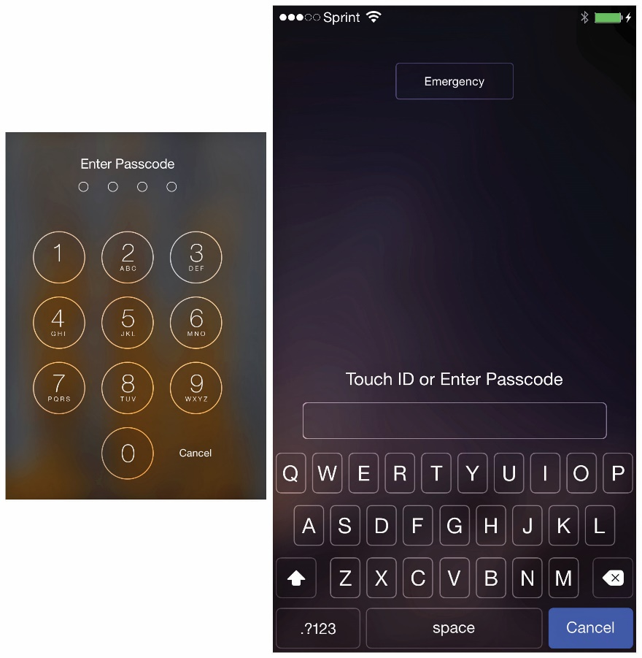
Figure 12.9 iOS lock screens
Notes:
As shown in Figure 12.9, the device screen on the left supports only a simple iOS passcode, limited to four numbers, while the device screen on the right supports a passcode of indeterminate length and can contain alphanumeric characters.

Slide 167
Mobile Device Security (continued)
GPS technology can be exploited to track movement location of the mobile device.
GPS tracking can be used to assist in the recovery of lost devices.
Storage segmentation involves separate virtual containers.
Personal data is kept separate from corporate data and applications.
This protection is strongly recommended for devices that are used to handle highly sensitive corporate data.

Slide 168
Mobile Device Security (continued)
Asset control entails implementing a viable asset tracking and inventory control mechanism.
For security and liability reasons, the company needs to know what devices are connecting to its systems and what access has been granted.
Just as in IT systems, maintaining a list of approved devices is a critical control.

Slide 169
Mobile Device Security (continued)
Mobile device management (MDM) began as a marketing term for a collective set of commonly employed protection elements associated with mobile devices.
Every corporation should have and enforce an MDM policy.
Password policies should extend to mobile devices.
Include lockout and the automatic wiping of data
Corporate policy for data encryption on mobile devices should be consistent with the policy for data encryption on laptop computers.
Notes:
The policy should require:
Device locking with a strong password
Encryption of data on the device
Device locking automatically after a certain period of inactivity
The capability to remotely lock the device if it is lost or stolen
The capability to wipe the device automatically after a certain number of failed login attempts
The capability to remotely wipe the device if it is lost or stolen
Password policies should extend to mobile devices, including lockout and, if possible, the automatic wiping of data. Corporate policy for data encryption on mobile devices should be consistent with the policy for data encryption on laptop computers. In other words, if you don’t require encryption of portable computers, then should you require it for mobile devices? There is not a uniform answer to this question; mobile devices are much more mobile in practice than laptops, and more prone to loss. This is ultimately a risk question that management must address: What is the risk and what are the costs of the options employed? This also raises a bigger question: Which devices should have encryption as a basic security protection mechanism? Is it by device type, or by user based on what data would be exposed to risk? Fortunately, MDM solutions exist to make the choices manageable.

Slide 170
Mobile Device Security (continued)
Device access control is critical as storage in the cloud and SaaS become more prevalent.
Rigorous data access principles need to be applied, and they become even more important with the inclusion of mobile devices as fully functional computing devices.
Features that are not used or that present a security risk should be disabled.
Bluetooth access is particularly problematic so users should receive training as to the risks of Bluetooth.
Notes:
The principles of access control for mobile devices need to be managed just like access control from wired or wireless desktops and laptops. This will become more critical as storage in the cloud and Software as a Service (SaaS) become more prevalent. Emerging tablet/mobile device sharing intends to provide the user with a seamless data access experience across many devices. Data access capabilities will continue to evolve to meet this need. Rigorous data access principles need to be applied, and they become even more important with the inclusion of mobile devices as fully functional computing devices. When reviewing possible solutions, it is important to consider seeking proof of security and procedures rather than relying on marketing brochures.
As with all computing devices, features that are not used or that present a security risk should be disabled. Bluetooth access is particularly problematic. It is best to make Bluetooth connections undiscoverable. But, users will need to enable it to pair with a new headset or car connection, for example. Requiring Bluetooth connections to be undiscoverable is very hard to enforce but should be encouraged as a best practice. Users should receive training as to the risks of Bluetooth—not so they avoid Bluetooth, but so they understand when they should turn it off. Having a mobile device with access to sensitive information carries with it a level of responsibility. Helping users understand this and act accordingly can go a long way toward securing mobile devices.

Slide 171
BYOD Concerns
Permitting employees to “bring your own device” (BYOD) has many advantages in business, and not just from the perspective of device cost.
Users tend to prefer having a single device rather than carrying multiple devices.
Users have less of a learning curve on devices they already have an interest in learning.

Slide 172
BYOD Concerns (continued)
BYOD blurs the lines of data ownership.
If a company owns a smartphone issued to an employee, the company can repossess the phone upon employee termination.
Practice may protect company data by keeping the company-issued devices in the hands of employees only.
A company cannot rely on a simple factory reset before reissuing a device.
Personal device used for business purposes may have some company data remains on the phone.
Notes:
BYOD blurs the lines of data ownership because it blurs the lines of device management. If a company owns a smartphone issued to an employee, the company can repossess the phone upon employee termination. This practice may protect company data by keeping the company-issued devices in the hands of employees only. However, a company cannot rely on a simple factory reset before reissuing a device, because factory resetting may not remove all the data on the device. If a device is reissued, it is possible that some of the previous owner’s personal information, such as private contacts, still remains on the device. On the other hand, if the employee’s device is a personal device that has been used for business purposes, upon termination of the employee, it is likely that some company data remains on the phone despite the company’s best efforts to remove its data from the device. If that device is resold or recycled, the company’s data may remain on the device and be passed on to the subsequent owner. Keeping business data in separate, MDM-managed containers is one method of dealing with this issue.

Slide 173
BYOD Concerns (continued)
Companies may use separate virtual containers to keep personal data separate from corporate data and applications.
Recommended for devices that are used to handle highly sensitive corporate data.
Support costs for mobile devices are an important consideration for corporations.
Each device has its own implementation of various functions.
Notes:
On mobile devices, it can be very difficult to keep personal data separate from corporate data. Some companies have developed capabilities to create separate virtual containers to keep personal data separate from corporate data and applications. For devices that are used to handle highly sensitive corporate data, this form of protection is highly recommended.
Support costs for mobile devices are an important consideration for corporations. Each device has its own implementation of various functions. While those functions typically are implemented against a specification, software implementations may not fully or properly implement the specification. This may result in increased support calls to your help desk or support organization. It is very difficult for a corporate help desk to be knowledgeable on all aspects of all possible devices that access a corporate network. For example, your support organization must be able to troubleshoot iPhones, Android devices, tablets, and so forth. These devices are updated frequently, new devices are released, and new capabilities are added on a regular basis. Your support organization will need viable knowledge base articles and job aids in order to provide sufficient support for the wide variety of ever-changing devices.

Slide 174
BYOD Concerns (continued)
Corporate policy should require mobile devices to be kept current with respect to patches.
It is an important best defense against viruses, malware, and other threats.
It is important to recognize that “jailbreaking” or “rooting” your device may remove the manufacturer’s security mechanisms and protection against malware and other threats.
Notes:
It is important to recognize that “jailbreaking” or “rooting” your device may remove the manufacturer’s security mechanisms and protection against malware and other threats. These devices may also no longer be able to update their applications or OS against known issues. Jailbreaking or rooting is also a method used to bypass security measures associated with the device manufacturer control, and in some locations, this can be illegal. Mobile devices that are jailbroken or rooted should not be trusted on your enterprise network or allowed to access sensitive data.

Slide 175
BYOD Concerns (continued)
Mobile devices need protection against viruses and malware.
Antivirus and malware protection should be employed as widely as possible and kept up-to-date.
Mobile device forensics is a rapidly evolving and fast-changing field.
Solid forensics principles should always be followed.
Notes:
Just like desktop and laptop computers, smartphones, tablets, and other mobile devices need protection against viruses and malware. It is important that corporate policy and personal usage keep operating systems and applications current. Antivirus and malware protection should be employed as widely as possible and kept up-to-date against current threats.
Mobile device forensics is a rapidly evolving and fast-changing field. Because devices are evolving so quickly and changing so fast, it is difficult to stay current in this field. Solid forensics principles should always be followed. Devices should be properly handled by using RF-shielded bags or containers. Because of the rapid changes in this area, it’s best to engage the help of trained forensic specialists to ensure data isn’t contaminated and the device state and memory are unaltered. If forensics are needed on a device that has both personal and business data, then policies need to be in place to cover the appropriate privacy protections on the personal side of the device.

Slide 176
BYOD Concerns (continued)
Personal devices used for work may lead to strong expectations that privacy will be protected by the company.
Policy needs to consider and address this explicitly.
Mobile devices include on-board cameras, and the photos/videos they take can divulge information.
Mobile devices may be used for illegal purposes.
This creates a liability for the company.
Notes:
When an employee uses his personal device to perform his work for the company, he may have strong expectations that privacy will be protected by the company. The company policy needs to consider this and address it explicitly. On company-owned devices, it’s quite acceptable for the company to reserve the right to access and wipe any company data on the device. The company can thus state that the user can have no expectation of privacy when using a company device. But when the device is a personal device, the user may feel stronger ownership. Expectations of privacy and data access on personal devices should be included in your company policy.
Many mobile devices include on-board cameras, and the photos/videos they take can divulge information. This information can be associated with anything the camera can image—whiteboards, documents, even the location of the device when the photo/video was taken via geo-tagging. Another challenge presented by mobile devices is the possibility that they will be used for illegal purposes. This can create liability for the company if it is a company-owned device. Despite all the potential legal concerns, possibly the greatest concern of mobile device users is that their personal photos will be lost during a device wipe originated by the company.

Slide 177
BYOD Concerns (continued)
On-boarding/off-boarding processes are essential.
When new employees join a company, the on-boarding processes need to include provisions for mobile device responsibilities.
Mobile devices supplied by the company should be collected upon termination.
BYOD equipment should have its access to corporate resources terminated as part of the off-boarding process.
Regular audits for old or unterminated accounts should be performed to ensure prompt deletion of accounts for terminated employees.
Notes:
Most companies and individuals find it relatively easy to connect mobile devices to the corporate network. Often there are not controls around connecting a device other than having a Microsoft Exchange account. When new employees join a company, the on-boarding processes need to include provisions for mobile device responsibilities. It is easy for new employees to bypass security measures if they are not part of the business process of on-boarding.
Employee termination needs to be modified to include termination of accounts on mobile devices. It’s not uncommon to find terminated employees with accounts or even company devices still connecting to the corporate network months after being terminated. E-mail accounts should be removed promptly as part of the employee termination policy and process. Mobile devices supplied by the company should be collected upon termination. BYOD equipment should have its access to corporate resources terminated as part of the off-boarding process. Regular audits for old or unterminated accounts should be performed to ensure prompt deletion of accounts for terminated employees.

Slide 178
BYOD Concerns (continued)
Corporate policies regarding BYOD devices should be consistent with your existing computer security policies.
Training programs should include instruction on mobile device security.
BYOD inherently creates a conflict between personal and corporate interests.
Corporate BYOD policy needs to be well defined, approved by the corporate legal department, and clearly communicated to all employees through training.
Notes:
Your corporate policies regarding BYOD devices should be consistent with your existing computer security policies. Your training programs should include instruction on mobile device security. Disciplinary actions should be consistent. Your monitoring programs should be enhanced to include monitoring and control of mobile devices.
BYOD inherently creates a conflict between personal and corporate interests. An employee who uses her own device to conduct corporate business inherently feels strong ownership over the device and may resent corporate demands to control corporate information downloaded to the device. On the other hand, the corporation expects that corporate data be properly controlled and protected and thus desires to impose remote wiping or lockout requirements in order to protect corporate data. An individual who loses her personal photos from a special event will likely harbor ill feelings toward the corporation if it wipes her device, including those irreplaceable photos. Your corporate BYOD policy needs to be well defined, approved by the corporate legal department, and clearly communicated to all employees through training.

Slide 179
BYOD Concerns (continued)
Mobile devices consume connections to your corporate IT infrastructure.
It is recommended that load testing be performed to ensure that your design or existing infrastructure can support the potentially large number of connections from multiple devices.
Multiple connections can also create security issues when the system tracks user accounts against multiple connections.
Notes:
Mobile devices consume connections to your corporate IT infrastructure. It is not unusual now for a single individual to be connected to the corporate infrastructure with one or more smartphones, tablets, and laptop or desktop computers. Some infrastructure implementations in the past have not been efficient in their design, sometimes consuming multiple connections for a single device. This can reduce the number of available connections for other end users. It is recommended that load testing be performed to ensure that your design or existing infrastructure can support the potentially large number of connections from multiple devices.
Multiple connections can also create security issues when the system tracks user accounts against multiple connections. Users will need to be aware of this, so that they don’t inadvertently create incident response situations or find themselves locked out by their own actions. This can be a tricky issue requiring a bit more intelligent design than the traditional philosophy of one userid equals one current connection.

Slide 180
BYOD Concerns (continued)
Many security challenges are presented by mobile devices used for corporate business.
Make sure you have solid legal review of policies.
One challenge is the possibility that mobile devices will be used for illegal purposes.
Can create liability if it is a company-owned device
An acceptable use policy should address authorized usage of corporate devices for personal purposes.
Disciplinary actions for violation should be defined.
Notes:
It should be apparent from the various topics discussed in this chapter that there are many security challenges presented by mobile devices used for corporate business. Because the technology is rapidly changing, it’s best to make sure you have solid legal review of policies. There are both legal and public relation concerns when it comes to mobile devices. Employees who use both company-owned and personal devices have responsibilities when company data is involved. Policies and procedures should be reviewed on a regular basis to stay current with technology.
Another challenge presented by mobile devices is the possibility that they will be used for illegal purposes. This can create liability for the company if it is a company-owned device.
Similar to your acceptable use policies for laptops and desktops, your mobile device policies should address acceptable use of mobile or BYOD devices. Authorized usage of corporate devices for personal purposes should be addressed. Disciplinary actions for violation of mobile device policies should be defined. BYOD offers both the company and the user advantages; ramifications should be specifically spelled out, along with the specific user responsibilities.

Slide 181
Location Services
Mobile devices by their specific nature can move, and hence location of the device can have significant ramifications with respect to its use.
Mobile devices can connect to multiple public Wi-Fi locations, and they can provide users with navigation and other location context-sensitive information, such as a local sale.
To enable this functionality, location services are a set of functions to enable, yet control, the location information possessed by the device.

Slide 182
Location Services (continued)
Geo-tagging is the posting of location information into a data stream signifying where the device was when the stream was created.
As many mobile devices include on-board cameras, and the photos/videos they take can divulge information, geo-tagging can make location part of any picture or video.
This information can be associated with anything the camera can image—whiteboards, documents, even the location of the device when the photo/video was taken via geo-tagging.
Notes:
Posting photos with geo-tags embedded in them has its use, but it can also unexpectedly publish information that users may not want to share. For example, if you use your smartphone to take a photo of your car in the driveway and then post the photo on the Internet in an attempt to sell your car, if geo-tagging was enabled on the smartphone, the location of where the photo was taken is embedded as metadata in the digital photo. Such a posting could inadvertently expose where your home is located. Some social media applications strip out the metadata on a photo before posting, but then they post where you posted it from in the posting itself. There has been much public discussion on this topic, and geo-tagging can be disabled on most mobile devices. It is recommended that it be disabled unless you have a specific reason for having the location information embedded in the photo.

Slide 183
Mobile Application Security
Applications that run on the devices represent security threats to the information that is stored on and processed by the device.
Applications are the software elements that can be used to violate security, even when the user is not aware.
Many games and utilities offer value to the user, but at the same time they scrape information stores on the device for information.

Slide 184
Mobile Application Security (continued)
Application control
Vendors do a reasonable job of making sure that offered apps are approved and do not create an overt security risk.
Many apps request access to various information stores on the mobile device as part of their business model.
Understanding what access is requested and approved upon installation of apps is an important security precaution.
Your company may have to restrict the types of apps that can be downloaded and used on mobile devices.

Slide 185
Mobile Application Security (continued)
Key and credential management
Key and credential management services are being integrated into most MDM services to ensure that existing strong policies and procedures can be extended to mobile platforms securely.
These services include protection of keys for digital signatures and S/MIME encryption and decryption.
Keys and credentials are among the highest-value items that can be found on mobile devices, so ensuring protection for them is a key element in mobile device security.
Notes:
The keys and credentials stored on the device can be used by multiple applications. Providing protection of these keys while still maintaining usability of them is an essential element of modern mobile application security.

Slide 186
Mobile Application Security (continued)
Authentication
When mobile devices are used to access business networks, authentication becomes an issue.
Mobile device can store certificates.
The authentication problem is moved to the endpoint, where it relies on passcodes, screen-locks, and other mobile device protections.
These can be weak unless structured together.
The risk in mobile authentication is that strong credentials stored in the device are protected by the less rigorous passcode and the end user.
Notes:
When mobile devices are used to access business networks, authentication becomes an issue. There are several levels of authentication that can be an issue. Is the device allowed to access the network? Is the user of the device a network user? If so, how do you authenticate the user? Mobile devices have some advantages in that they can store certificates, which by their very nature are more secure than passwords. This moves the authentication problem to the endpoint, where it relies on passcodes, screen-locks, and other mobile device protections. These can be relatively weak unless structured together, including wiping after a limited number of failures. The risk in mobile authentication is that strong credentials stored in the device are protected by the less rigorous passcode and the end user. End users can share their mobile devices, and by proxy unwittingly share their strong corporate authentication codes.

Slide 187
Mobile Application Security (continued)
Application whitelisting
Application whitelisting and blacklisting enables you to control and block applications available on the device.
Application whitelisting can improve security by preventing unapproved applications from being installed and run on the device.
Encryption
Encrypt both the device and applications.
The only way to segregate data within the device is for apps to manage their own data stores through app-specific encryption.
Notes:
As discussed in the “Application Control” section earlier in the chapter, controlling what applications a device can access may be an important element of your company’s mobile device policy. Application whitelisting and blacklisting enables you to control and block applications available on the mobile device. This is usually administered through some type of MDM capability. Application whitelisting can improve security by preventing unapproved applications from being installed and run on the device.
Just as the device should be encrypted, thereby protecting all information on the device, applications should be encrypted as well. Just employing encryption for the data store is not sufficient. If the device is fully encrypted, then all apps would have to have access to the data, in essence bypassing the encryption from an app point of view. Apps with sensitive information should control access via their own set of protections. The only way to segregate data within the device is for apps to manage their own data stores through app-specific encryption. This will allow sensitive data to be protected from rogue applications that would leak data if uniform access was allowed.

Slide 188
Mobile Application Security (continued)
Transitive trust/authentication
Trust relationships can be very complex in mobile devices, and often security aspects are not properly implemented.
Mobile devices tend to be used across numerous systems, including business, personal, public, and private.
This greatly expands the risk profile and opportunity for transitive trust–based attacks.
As with all other applications, mobile applications should be carefully reviewed to ensure that trust relationships are secure.
Notes:
Security across multiple domains/platforms is provided through trust relationships. When trust relationships between domains or platforms exist, authentication for each domain trusts the authentication for all other trusted domains. Thus when an application is authenticated, its authentication is accepted by all other domains/platforms that trust the authenticating domain or platform. Trust relationships can be very complex in mobile devices, and often security aspects aren’t properly implemented. Mobile devices tend to be used across numerous systems, including business, personal, public, and private. This greatly expands the risk profile and opportunity for transitive trust–based attacks. As with all other applications, mobile applications should be carefully reviewed to ensure that trust relationships are secure.

Slide 189
Chapter Summary
Describe the different wireless systems in use today.
Detail WAP and its security implications.
Identify 802.11’s security issues and possible solutions.
Examine the elements needed for enterprise wireless deployment.
Examine the security of mobile systems.

